Slide 1
Intrinsic Evaluation of Text Based Document Representation Models
Better Together

Slide 2

Better Together

Slide 3
SciBERT
BERT-style model trained on full text from Semantic Scholar (Beltagy et al., 2019)
1.14M papers
“18% papers from the computer science domain and 82% from the broad biomedical domain”
“Full text” → English only!

Slide 4
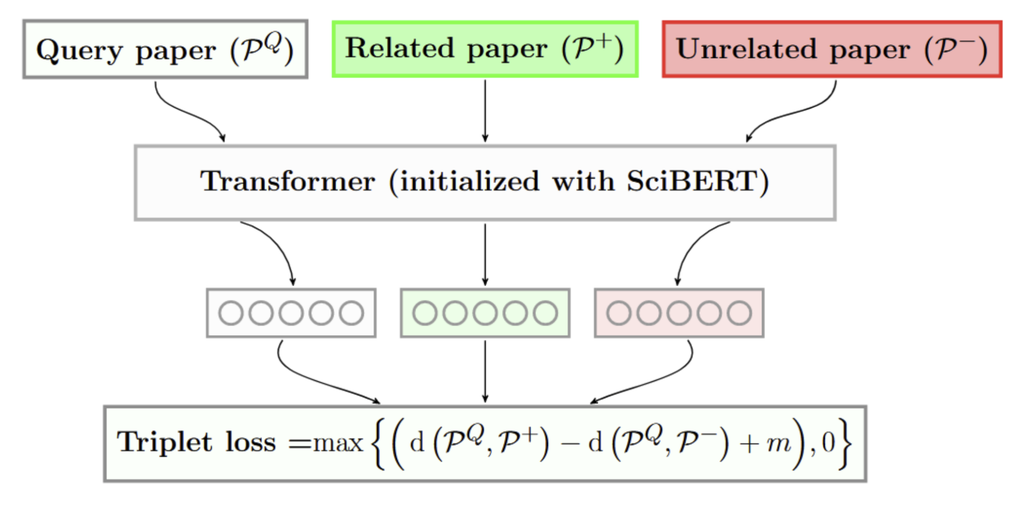
SPECTER
Document representation model based on Transformers (Cohan et al., 2020)
Post-pretraining alignment of SciBERT using citation graph

Slide 5
Goal: Intrinsic Evaluation of SPECTER
Hypothesis 1: The quality of SPECTER embeddings can only be as good as the quality of SciBERT representations
We can use perplexity to intrinsically evaluate how “expected” a piece of text is to the language model (SciBERT)
Hypothesis 2: The quality of SPECTER embeddings should be correlated to the perplexity of SciBERT

Slide 6
Perplexity as evaluation
Hypothesis: Perplexity is important. Document representation quality is related to the quality of the underlying language model
Language model perplexity is a measure of how “expected” a piece of text is to the model
So, we can use this measure as a signal of how well we would expect a model to represent a given document

Slide 7
How can we use this?
Evaluate how well the model can represent papers from different time periods and sources
Find specific areas that the model can improve on
How robust is the model to text written after its training data?
i.e. How variable is our scientific language over time?

Slide 8
Research Questions
RQ1: Perplexity is often reported as a single point.
Does perplexity vary by time and domain?
If so, what are the potential causes for variation?
RQ2: Will language models produce high quality representations for scientific text produced after the model’s release?

Slide 9
Experimental Setup
Partitioned papers from Semantic Scholar into 100 bins of equal size
Sample 5,000 abstracts from each bin
Representative sample – do not just evaluate the model on data it’s been trained on
Calculate a perplexity per-bin for multiple models

Slide 10
Experimental Setup: Data
Some data cleaning is required:
Filter abstracts with less than 75 characters
Filter abstracts with less than 10 unique characters

Slide 11
Experimental Setup: Perplexity Calculation
BERT-style models do not have a well-defined perplexity
Instead, use model scoring (Salazar et al., 2021) to calculate a pseudo-perplexity (per-subword)

Slide 12
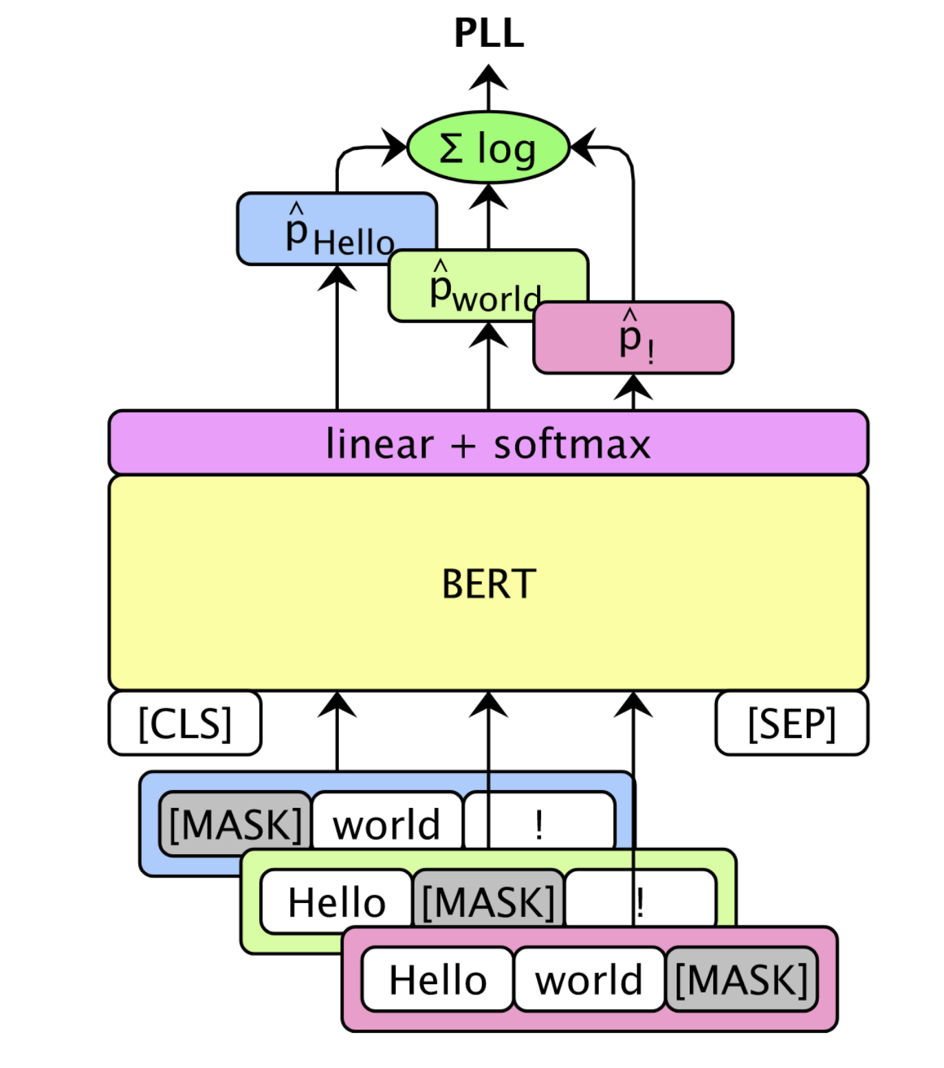
Pseudo Perplexity (PPPL)
BERT-style models do not have a well defined perplexity
Instead, use model scoring (Salazar et al., 2021)

Slide 13
Pseudo Perplexity (PPPL)
“patricks pickled peppers”
[CLS]
pat
##ricks
pick
##led
pepper
[SEP]
101
26227
23587
3368
2433
18700
102
log(p(pat))
∑ = PLL(w)
|V|
log(p(##ricks))
log(...)
log(...)
log(...)
Pseudo log-likelihood
101
[MASK]
23587
3368
2433
18700
102
101
26227
[MASK]
3368
2433
18700
102
101
26227
23587
[MASK]
2433
18700
102
101
26227
23587
3368
[MASK]
18700
102
101
26227
23587
3368
2433
[MASK]
102
Notes:
BERT-style models do not have a well defined perplexity
Instead, use model scoring (Salazar et al., 2021)

Slide 14
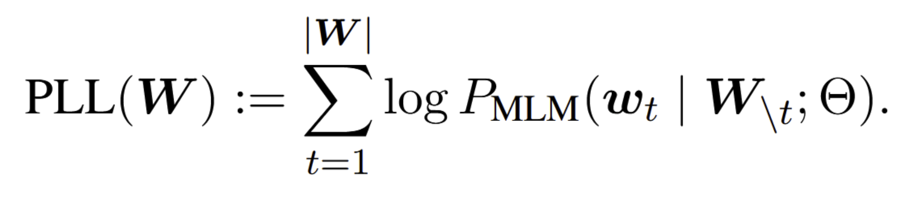
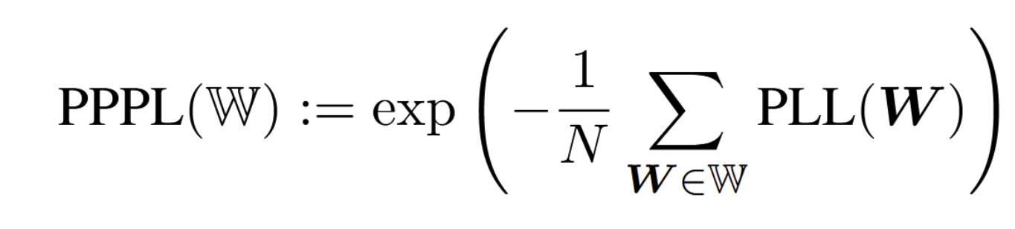
Scoring Calculation:
Abstract
# Tokens in Bin
Bin

Slide 15
Experiment Setup: Scoring
Get scores for the filtered abstracts: tokenize the abstracts, and use a maximum sequence length of 128
Further filtering:
Discard anything with more than 64 pad tokens
Discard anything with more than 10 [UNK] tokens
Results: plot pseudo-perplexity for each bin

Slide 16
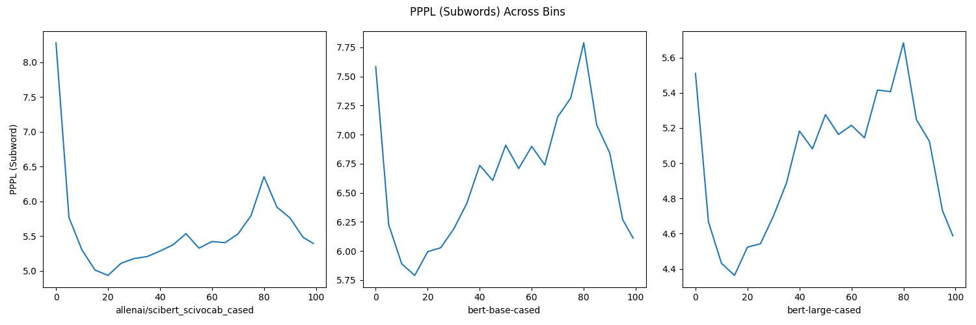
Past Analysis of BERT-like Models
Observations: see changes in perplexity across time (RQ1)
The perplexity difference from one bin to the next bin is relatively small

Slide 17
Past Analysis of BERT-like Models
Observation: pattern is the same for other BERT models

Slide 18
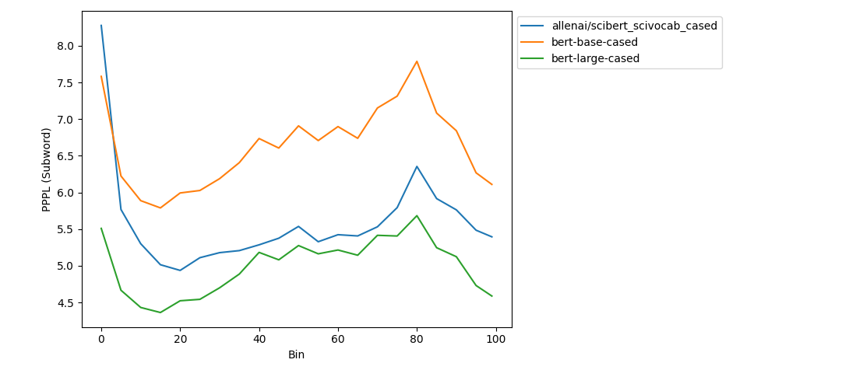
Past Analysis of BERT-like Models
Same vocabulary: directly comparable
More parameters in the model yields better perplexity

Slide 19
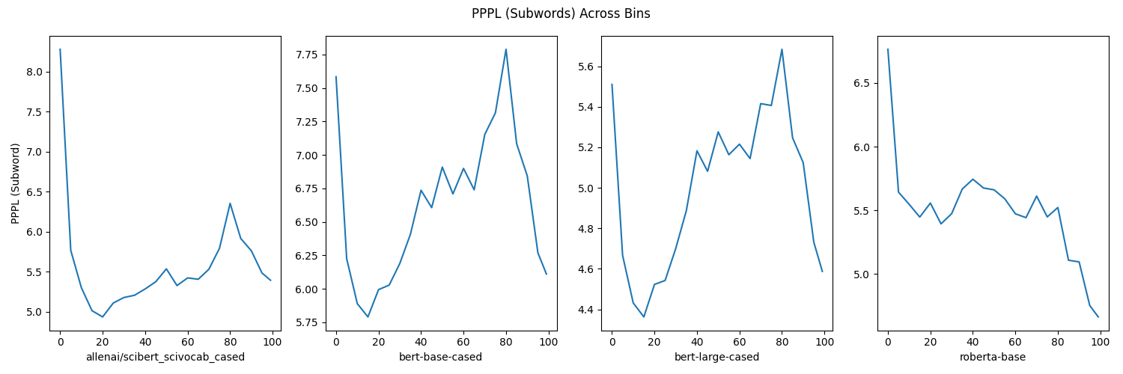
Other Architectures
Different architecture shows different trend

Slide 20
Comparison Across Vocabularies
Normalization value is the number of subwords,
which is different across tokenizers
Can use a count which is more consistent across models:
Words (Moses tokenization)
Characters
Spaces
Normalizer

Slide 21
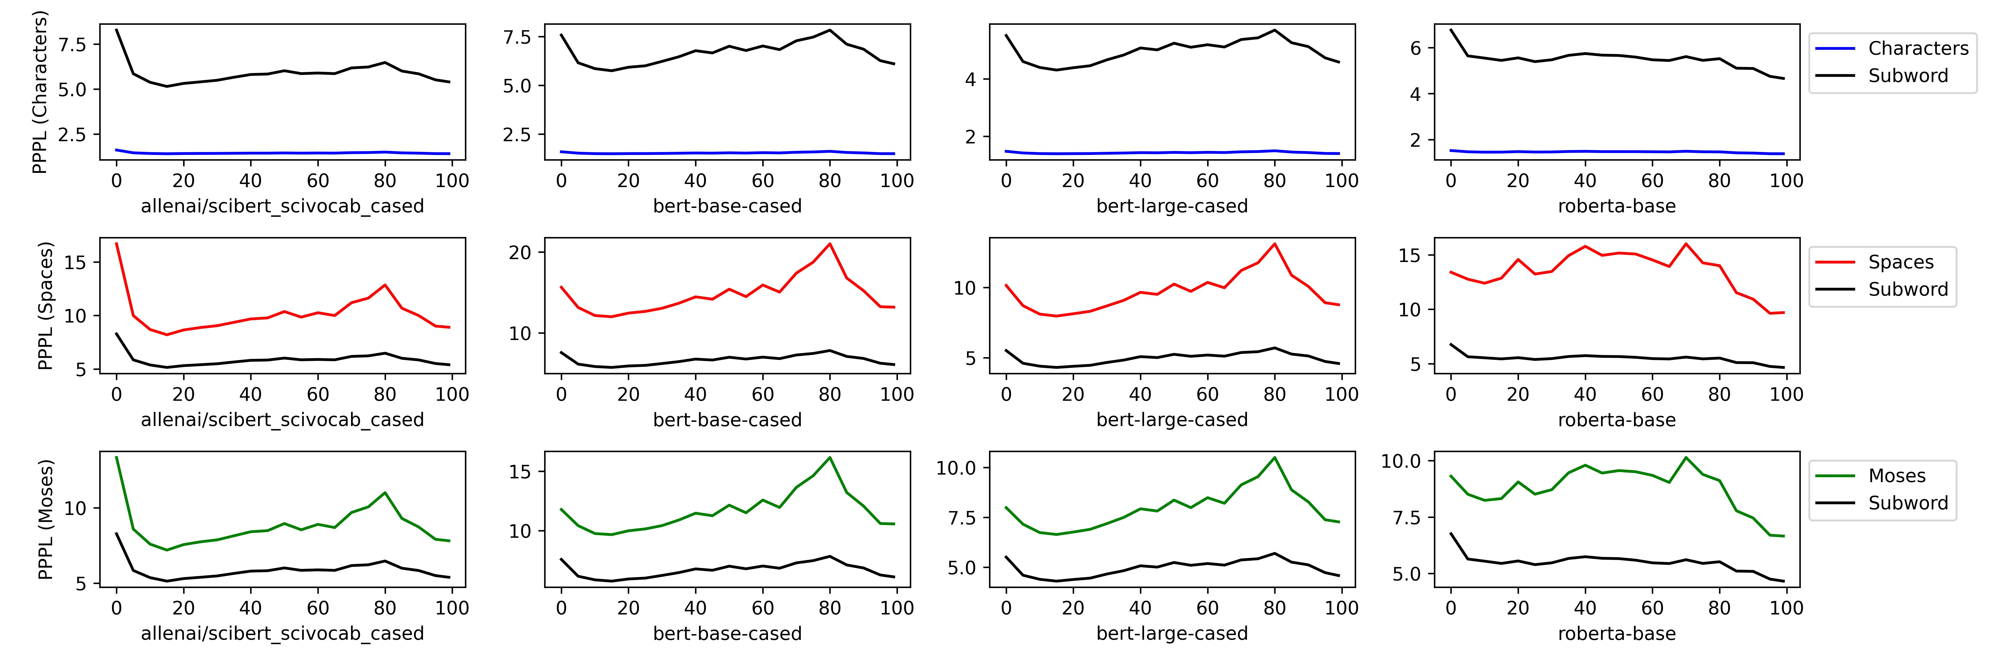
Different Normalization Methods

Slide 22
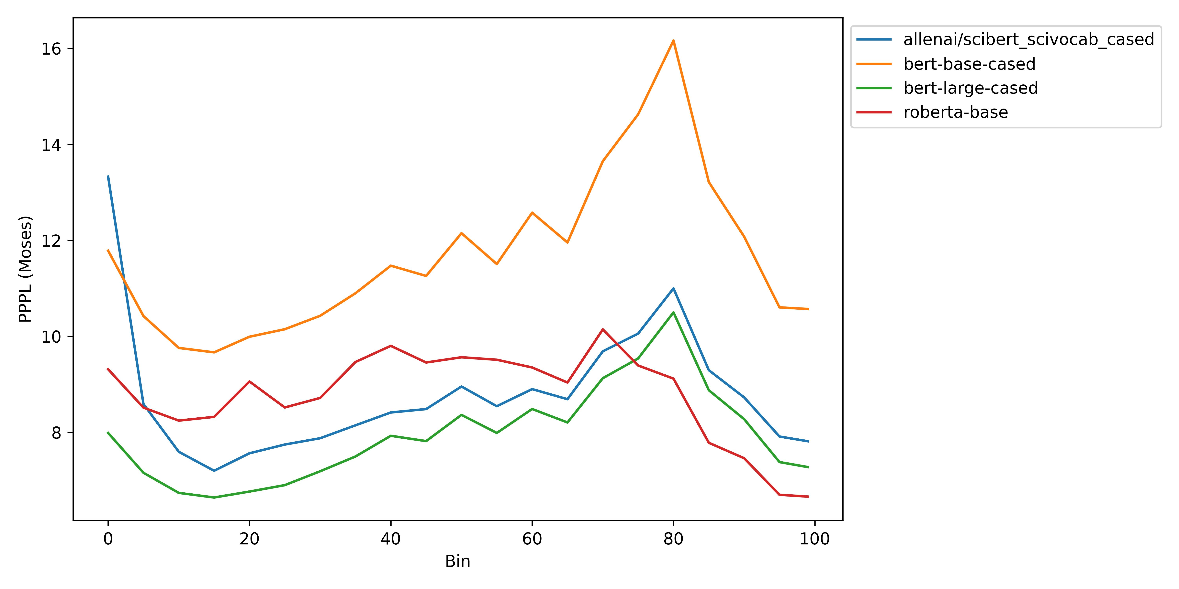
Model Comparison
Even with more consistent normalization, we still see the same ranking of models and trends over time

Slide 23
Reasons for this structure over time?
Features of language: is our writing style, vocabulary use, syntax, etc. changing over time? (Enough that it affects the model performance)
Features of the data: papers from new sources are suddenly added in one year, data from some years is noisy, etc.
Need to focus on the data before we can make claims about language

Slide 24
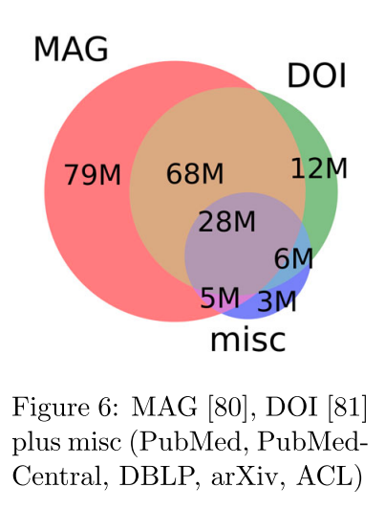
Data Features: Language and Source
Stratify the perplexity scores by filtering by source and language
Different sources may have different levels of quality control
Languages other than English will have a large effect on perplexity

Slide 25
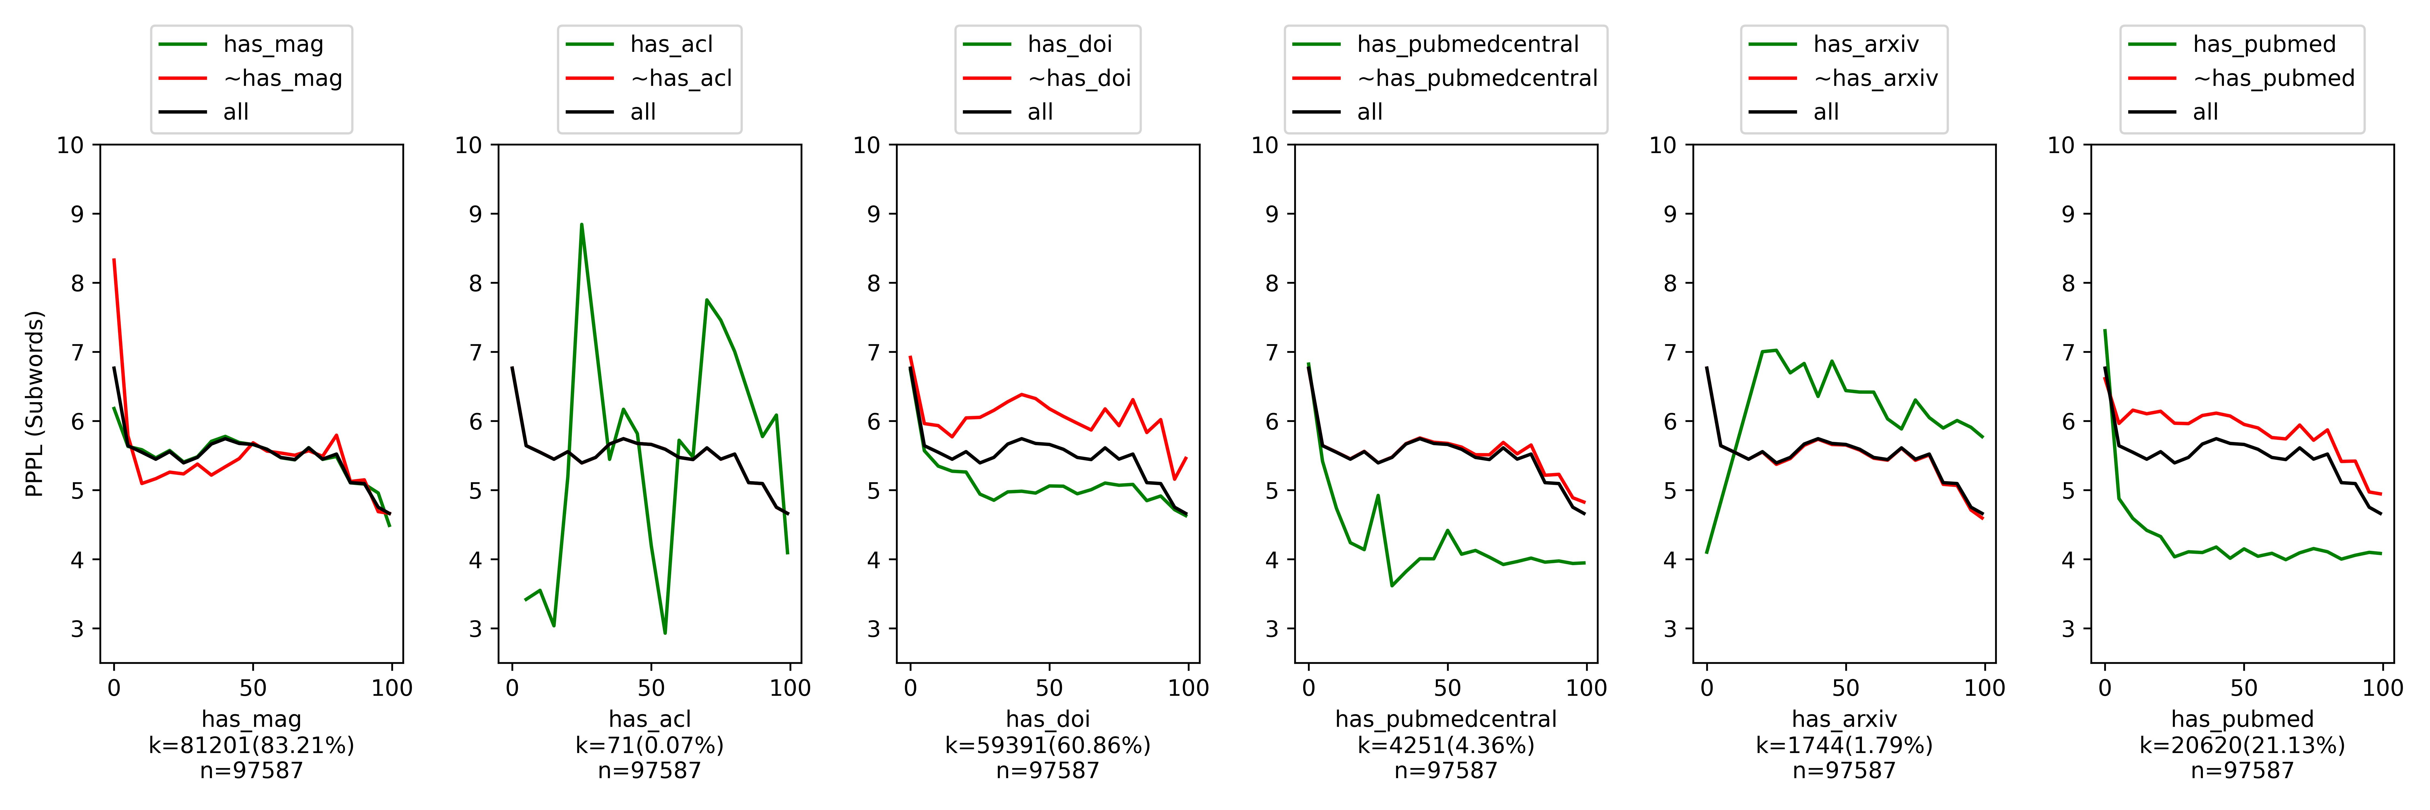
Stratifying by Source
Perplexity low and consistent for papers from PubMed, which makes up for ~20% of the sample
Papers not from PubMed are heavily influencing the shape of the perplexity curve
Similar story for DOI: papers without DOI are influential

Slide 26
Stratifying By Source Domain
MAG is less informative
ACL and ArXiv are too small in the sample to say anything

Slide 27
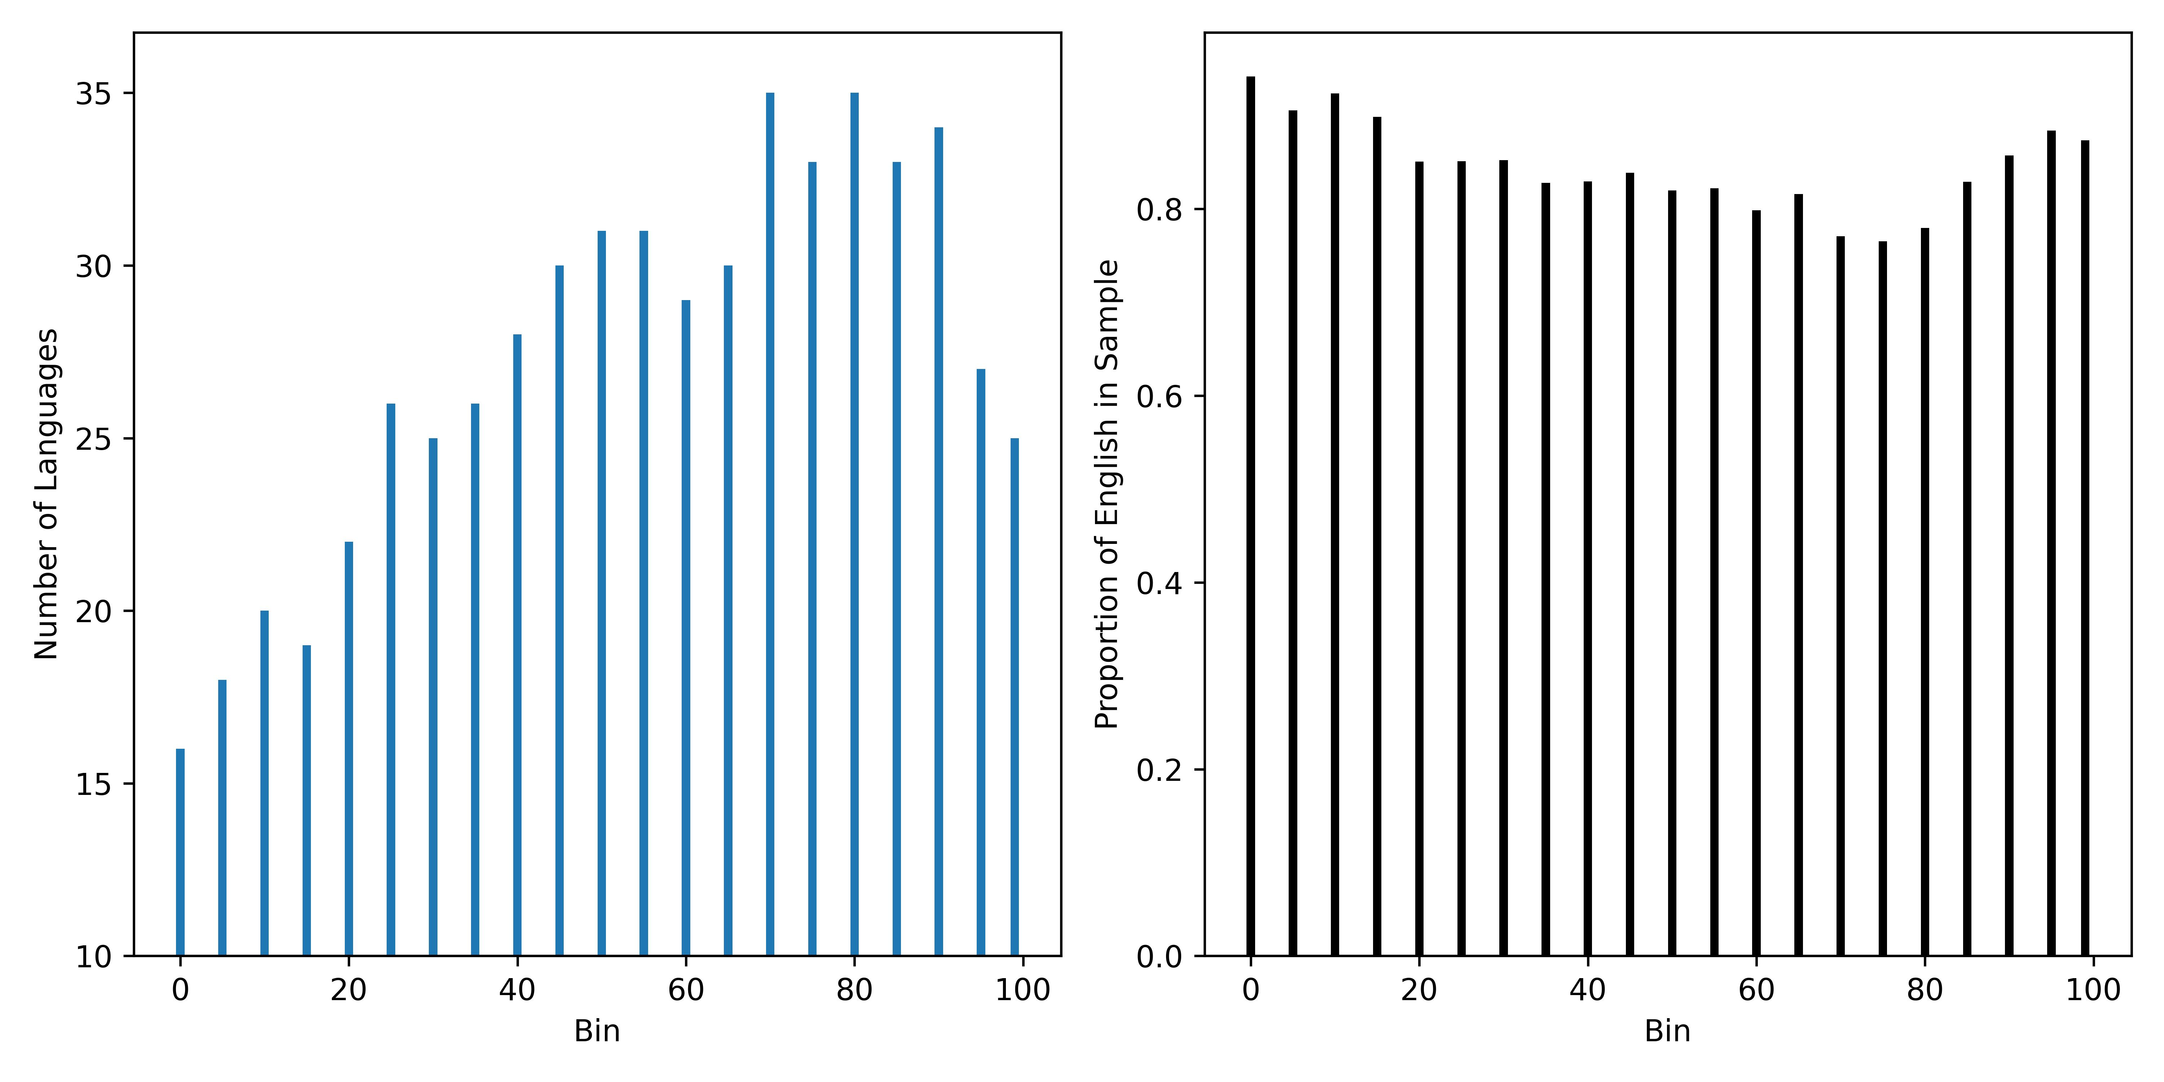
Stratifying by Language
Run language detection on the abstracts
Finding: multilinguality!

Slide 28
Stratifying by Language
English is still dominant: at least 80% of papers in all bins are English
How large is the effect?
Compare perplexities to that of a multilingual model
Stratify by abstracts which are English and non-English

Slide 29
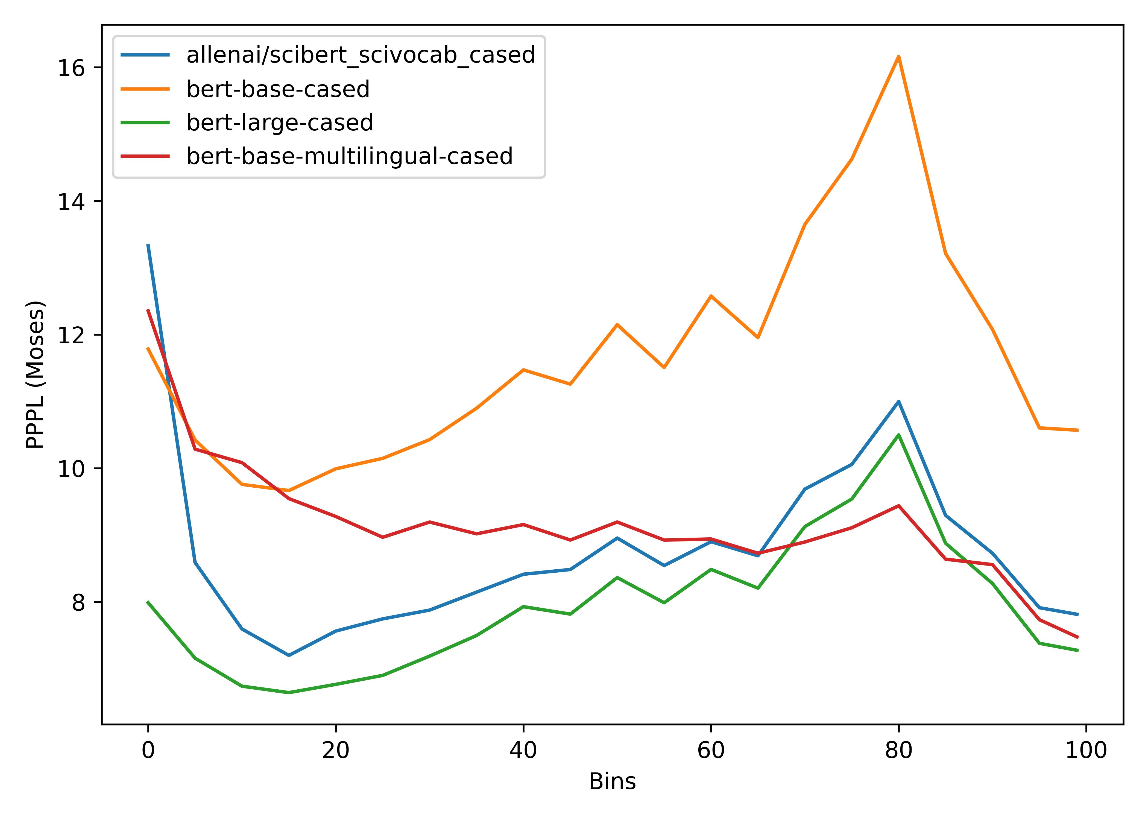
Multilingual Models
As the number of languages increases (peak at 80), perplexity of the model decreases

Slide 30
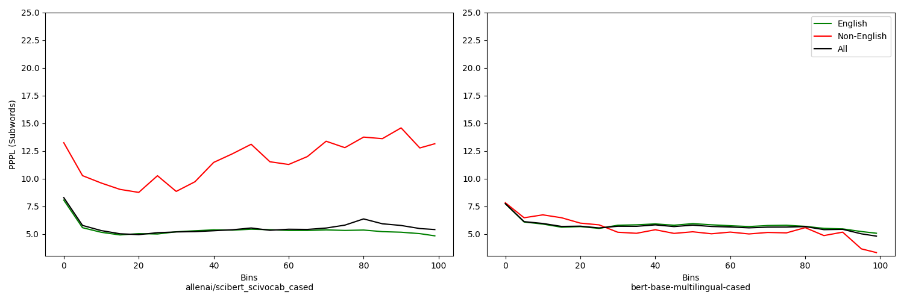
Effect of Non-English Abstracts

Slide 31
Takeaways: Multilinguality
Our scientific literature is multilingual, our models should be too
SciBERT, SPECTER, and SciRepEval all fail the Bender Test (Bender, 2011)
Not only are they trained solely on English, but they fail to mention that they are in English
If our models are trained on English and our evaluation is only in English we are ignoring a large piece of scientific literature
Better Together: A citation is a citation regardless of language.

Slide 32
So far:
Seen that the structure we noticed in our perplexities is largely due to the data:
More non-English papers affect the English-only models
Can we still analyze features of the languages?
RQ2: Will language models produce high quality representations for scientific text produced after its release?
Look at perplexities for only clean, English data

Slide 33
“Clean” Data
What do we consider to be “clean” data?
PubMed as a source is much cleaner
Perplexities on PubMed data are low and consistent

Slide 34
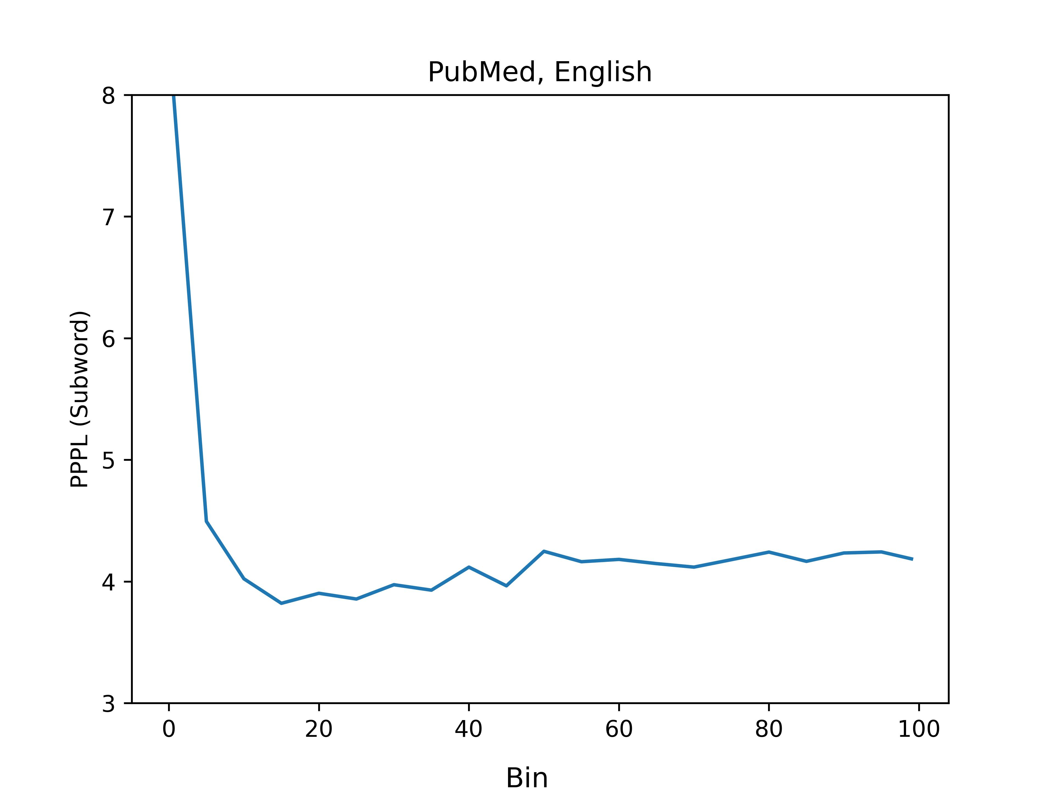
“Clean” Data
Perplexity for clean data is largely flat
Intuition: this is the training data, the model is very good at handling it
Can’t say anything about language changes over time
But, this doesn’t mean it doesn’t exist
Use other metrics on a sample of PubMed

Slide 35
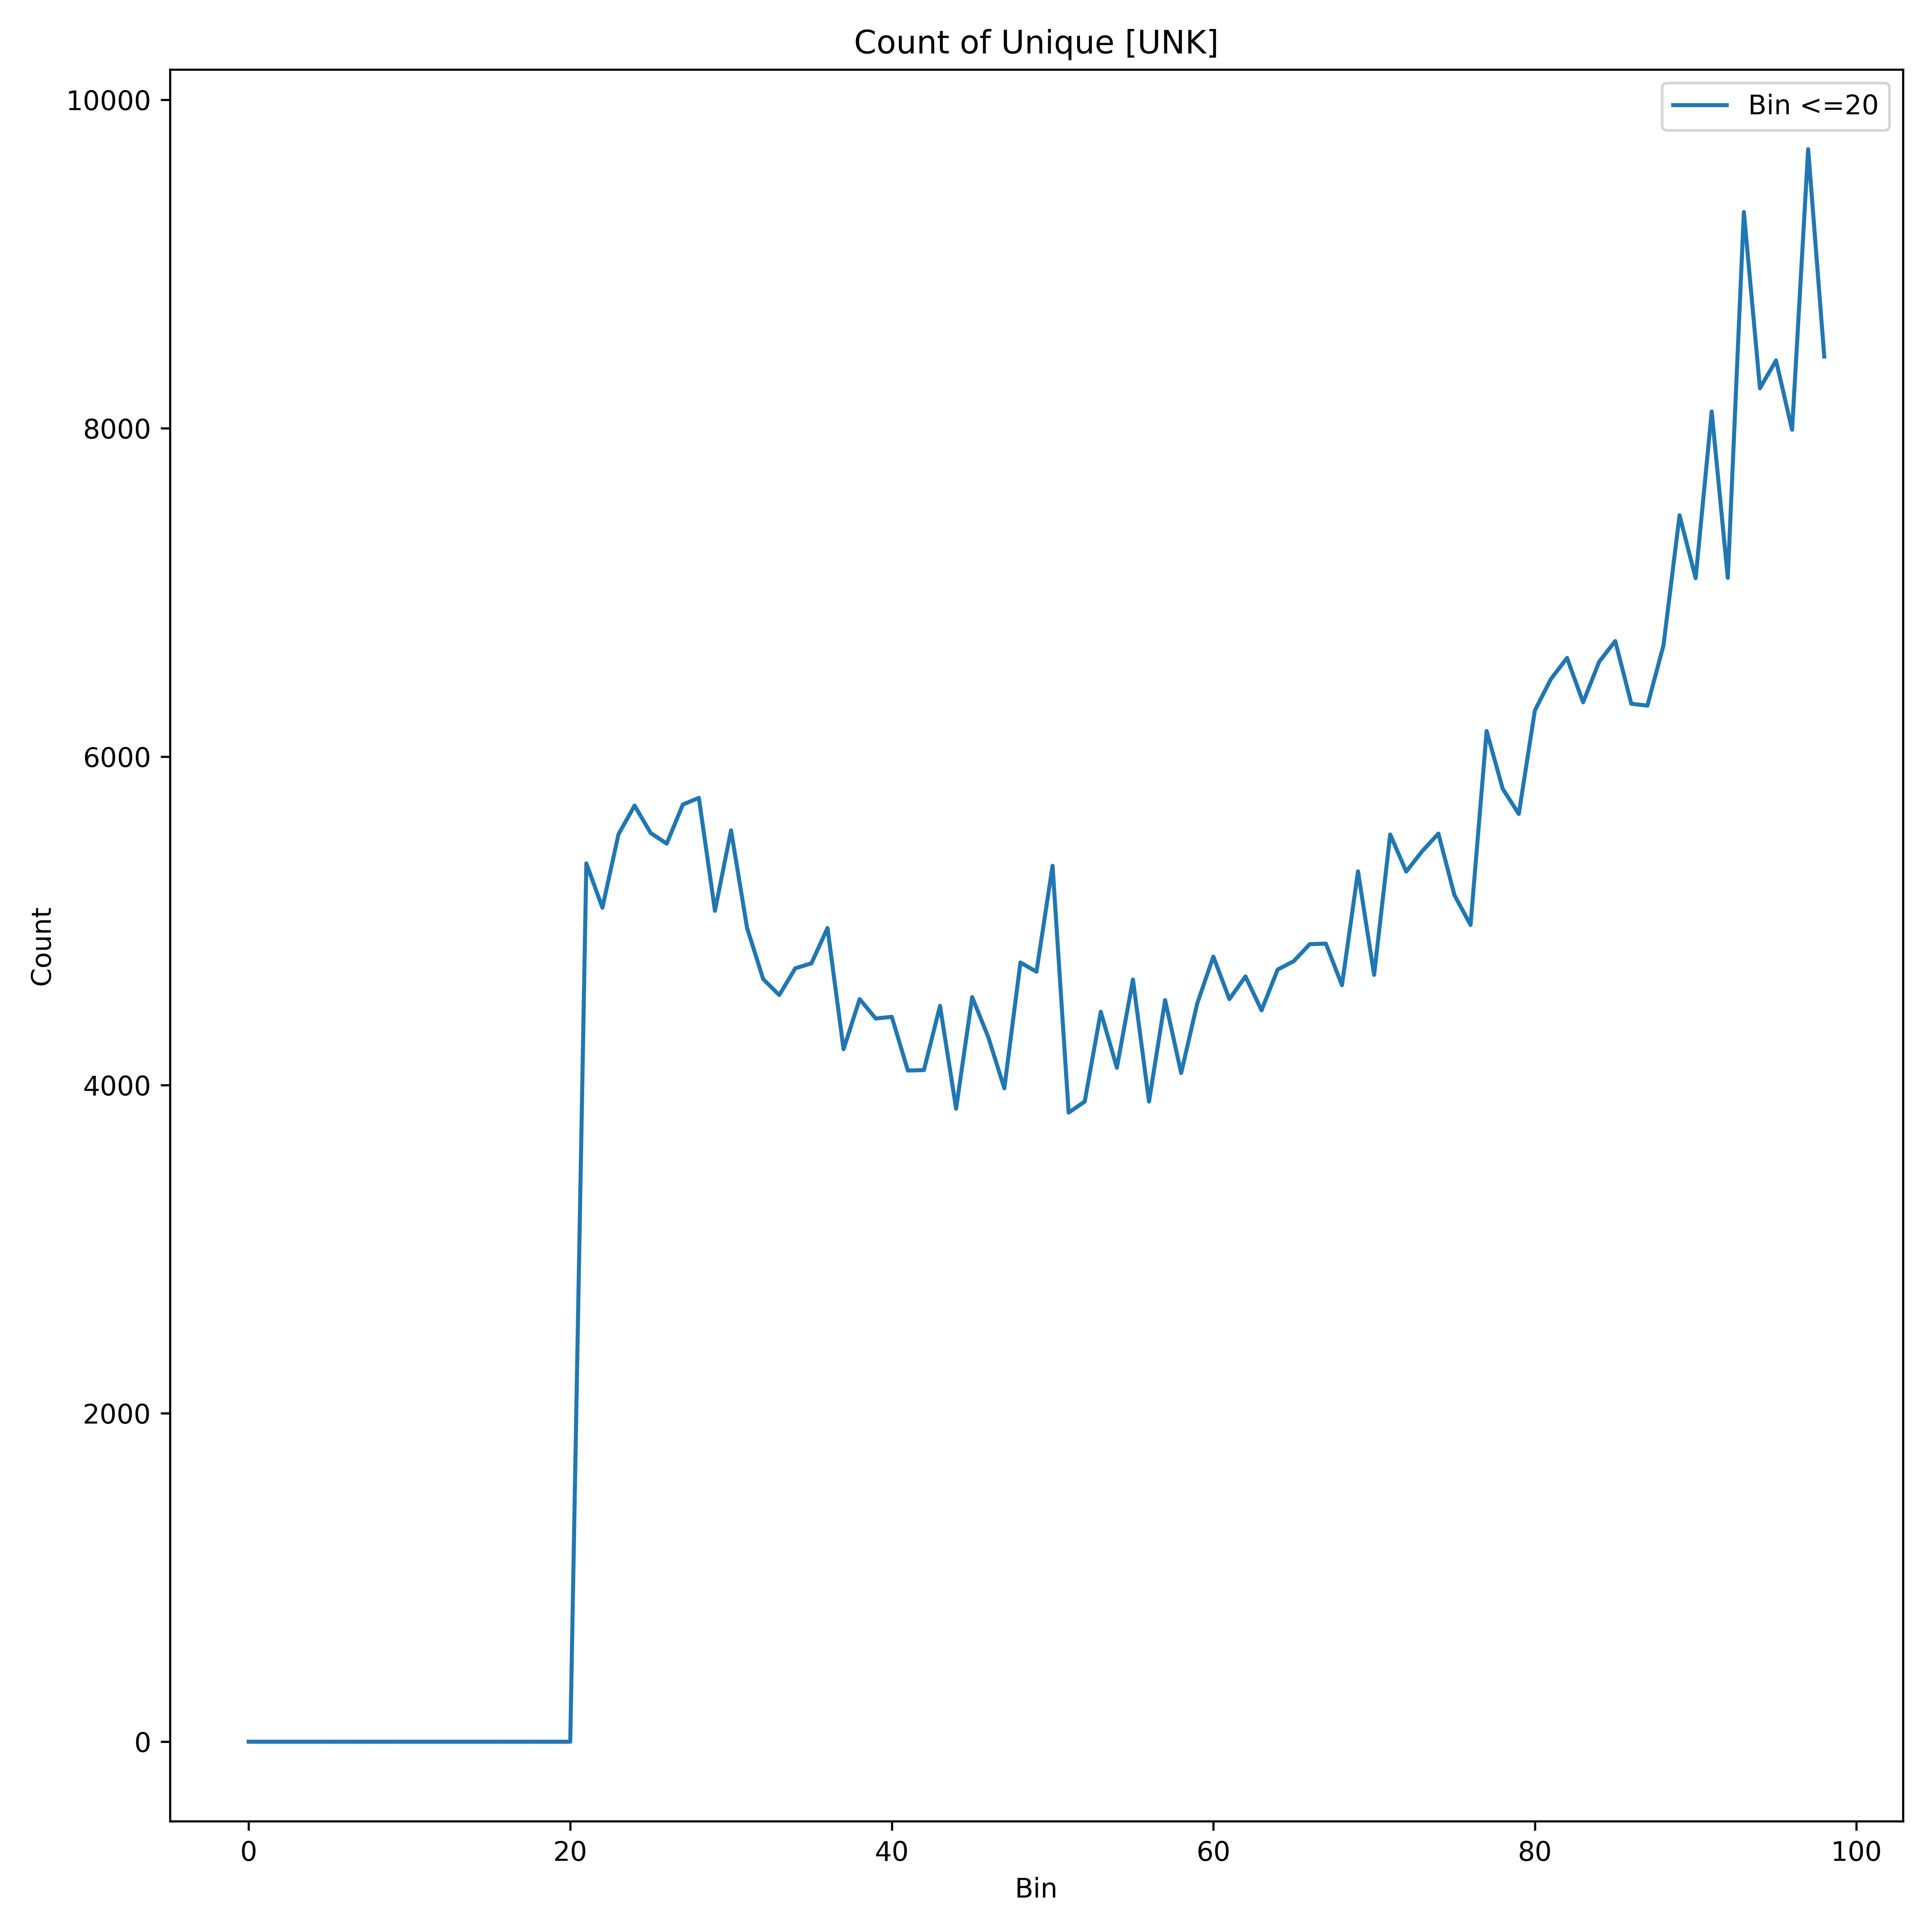
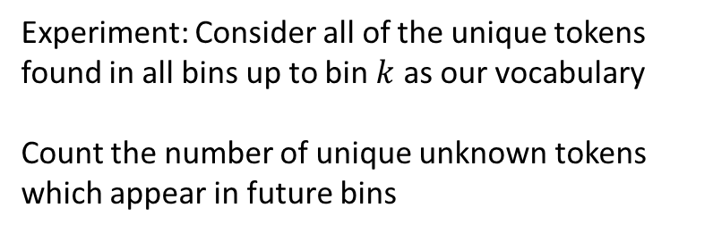
Emergence of New/UNK Tokens
Experiment: Consider all of the unique tokens found in all bins up to bin $k$ as our vocabulary
Count the number of unique unknown tokens which appear in future bins
The number of unknown words is consistently increasing.

Slide 36
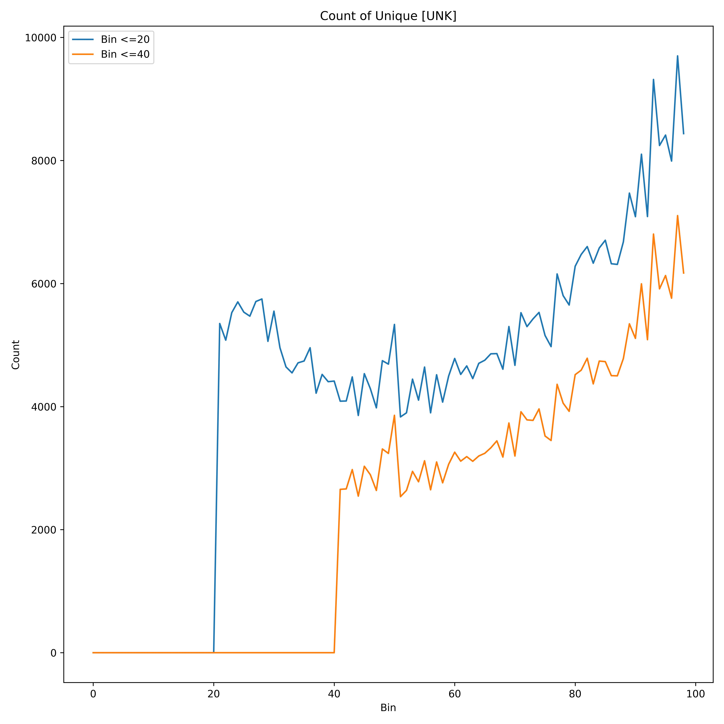
Emergence of New/UNK Tokens
Experiment: Consider all of the unique tokens found in all bins up to bin $k$ as our vocabulary
Count the number of unique unknown tokens which appear in future bins
The number of unknown words is consistently increasing.

Slide 37
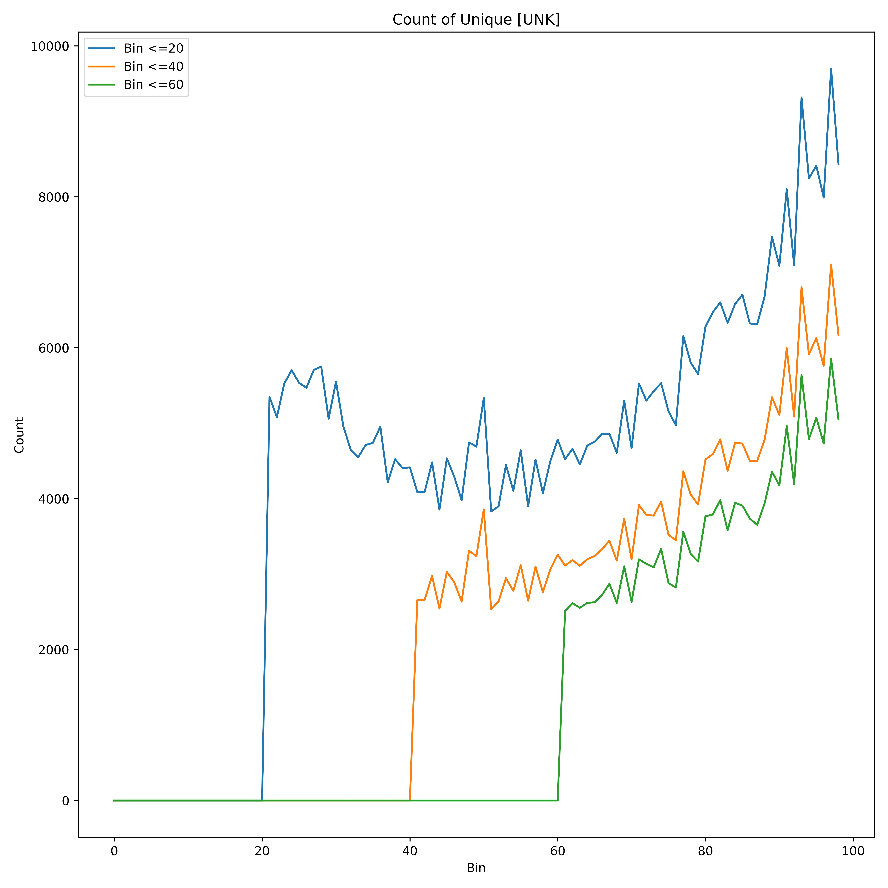
Emergence of New/UNK Tokens
Experiment: Consider all of the unique tokens found in all bins up to bin $k$ as our vocabulary
Count the number of unique unknown tokens which appear in future bins
The number of unknown words is consistently increasing.

Slide 38
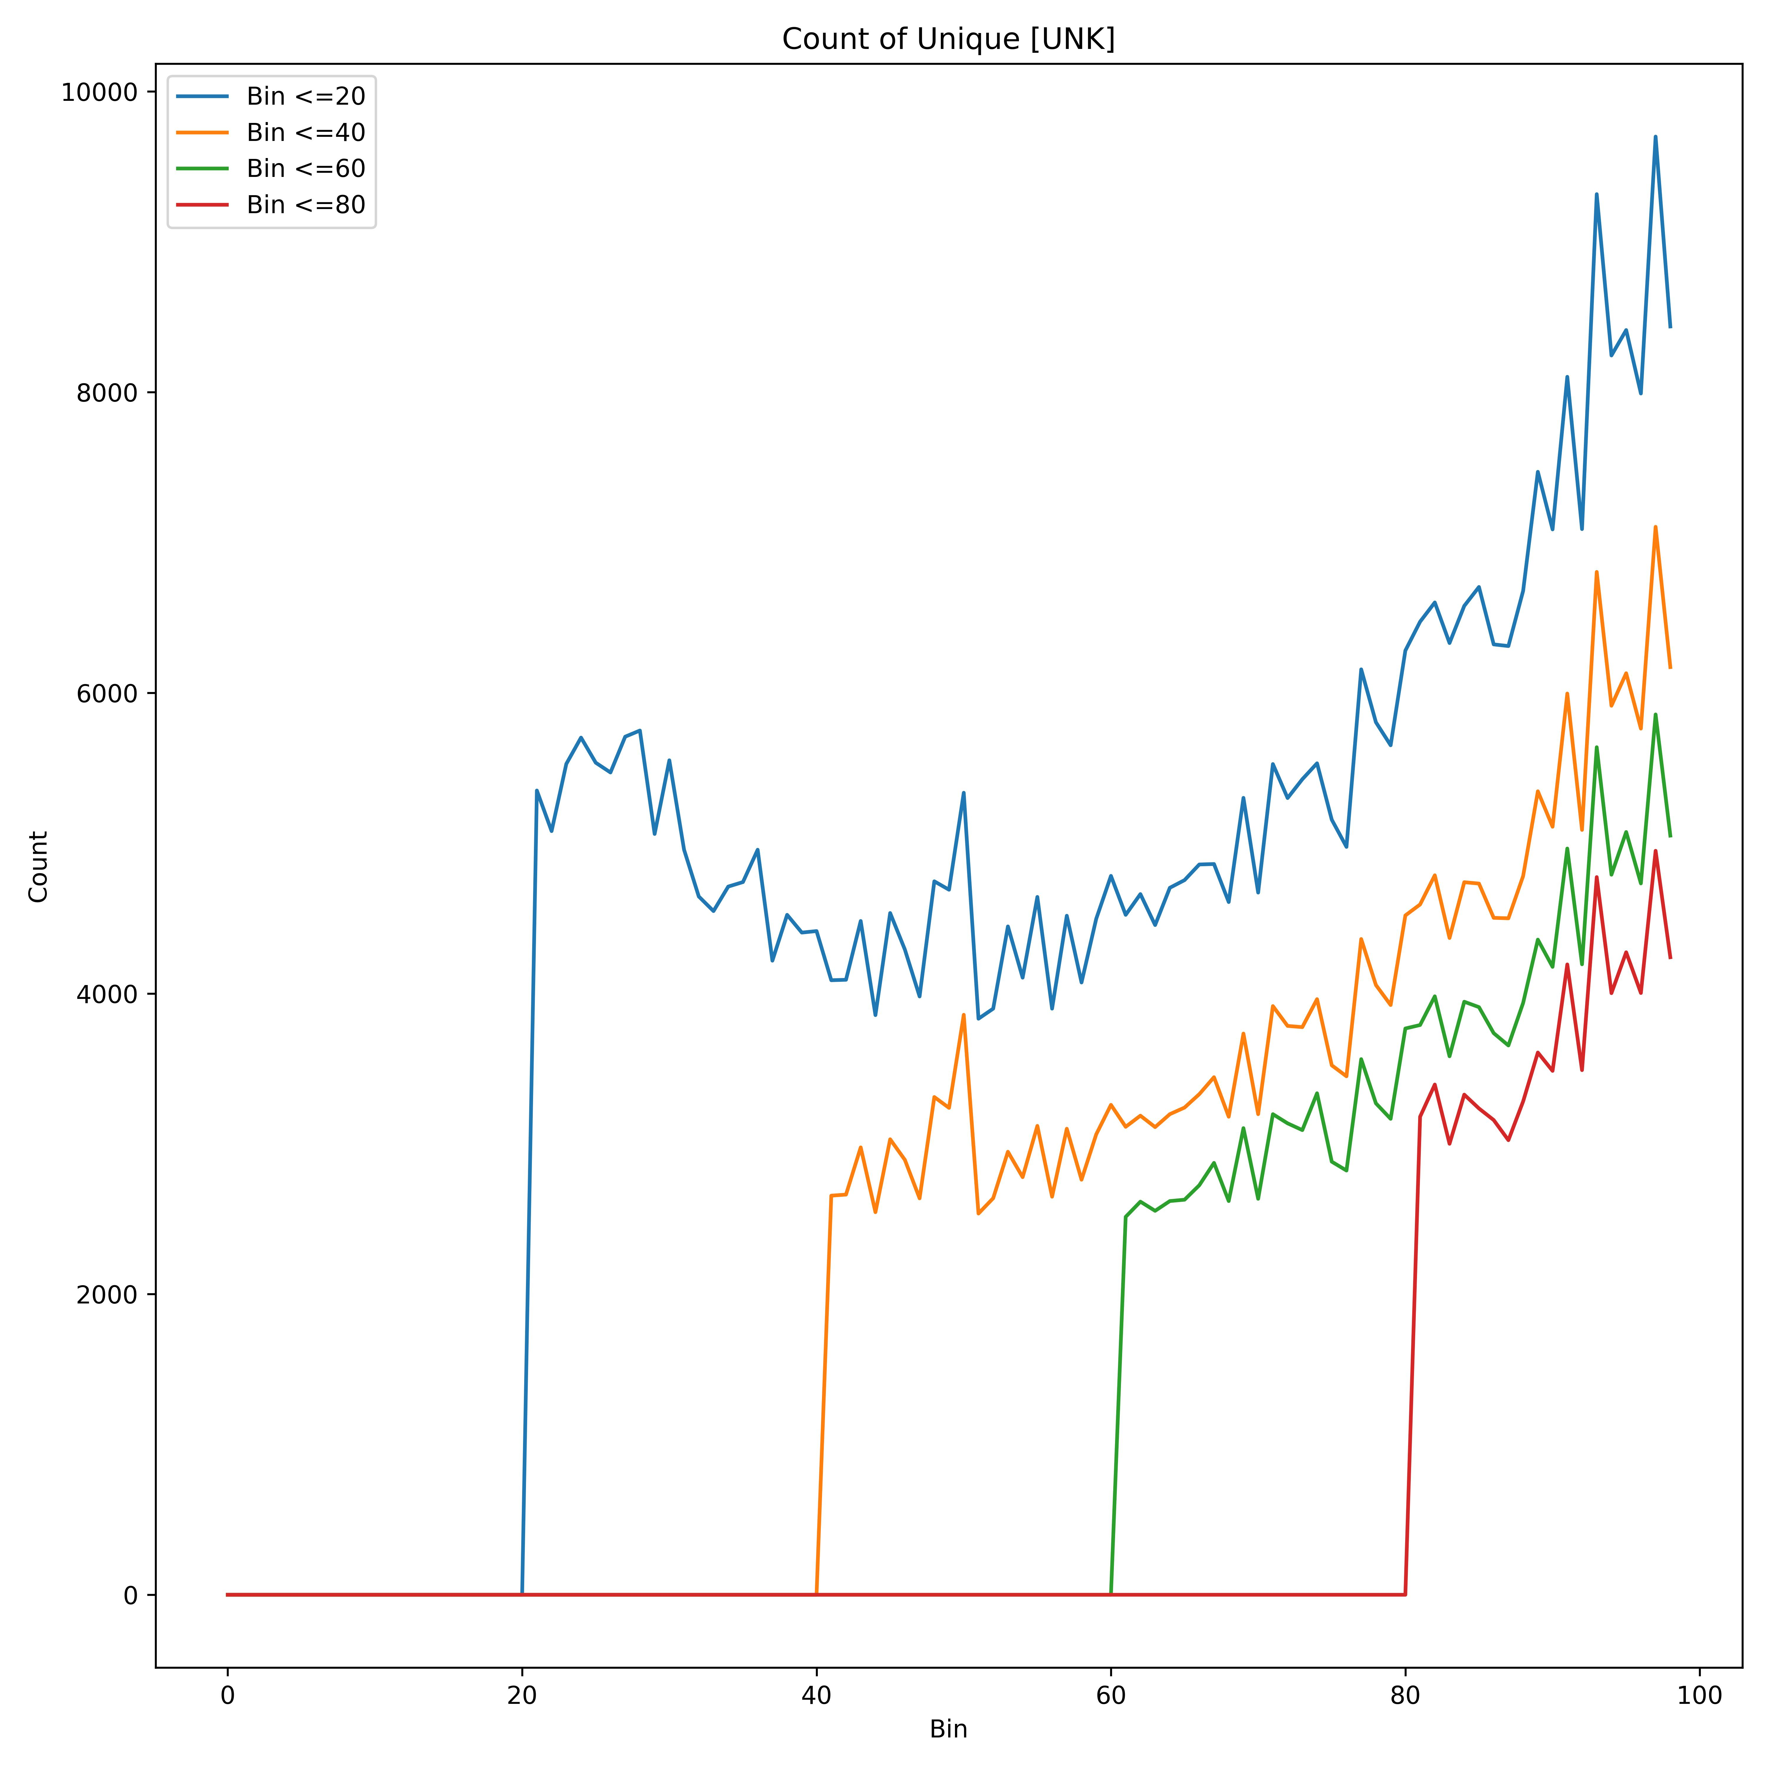
Emergence of New/UNK Tokens
Experiment: Consider all of the unique tokens found in all bins up to bin $k$ as our vocabulary
Count the number of unique unknown tokens which appear in future bins
Regardless of the vocabulary size, the number of unknown words is consistently increasing.
There are always words which did not appear in the previous years, and our models will have to handle this

Slide 39
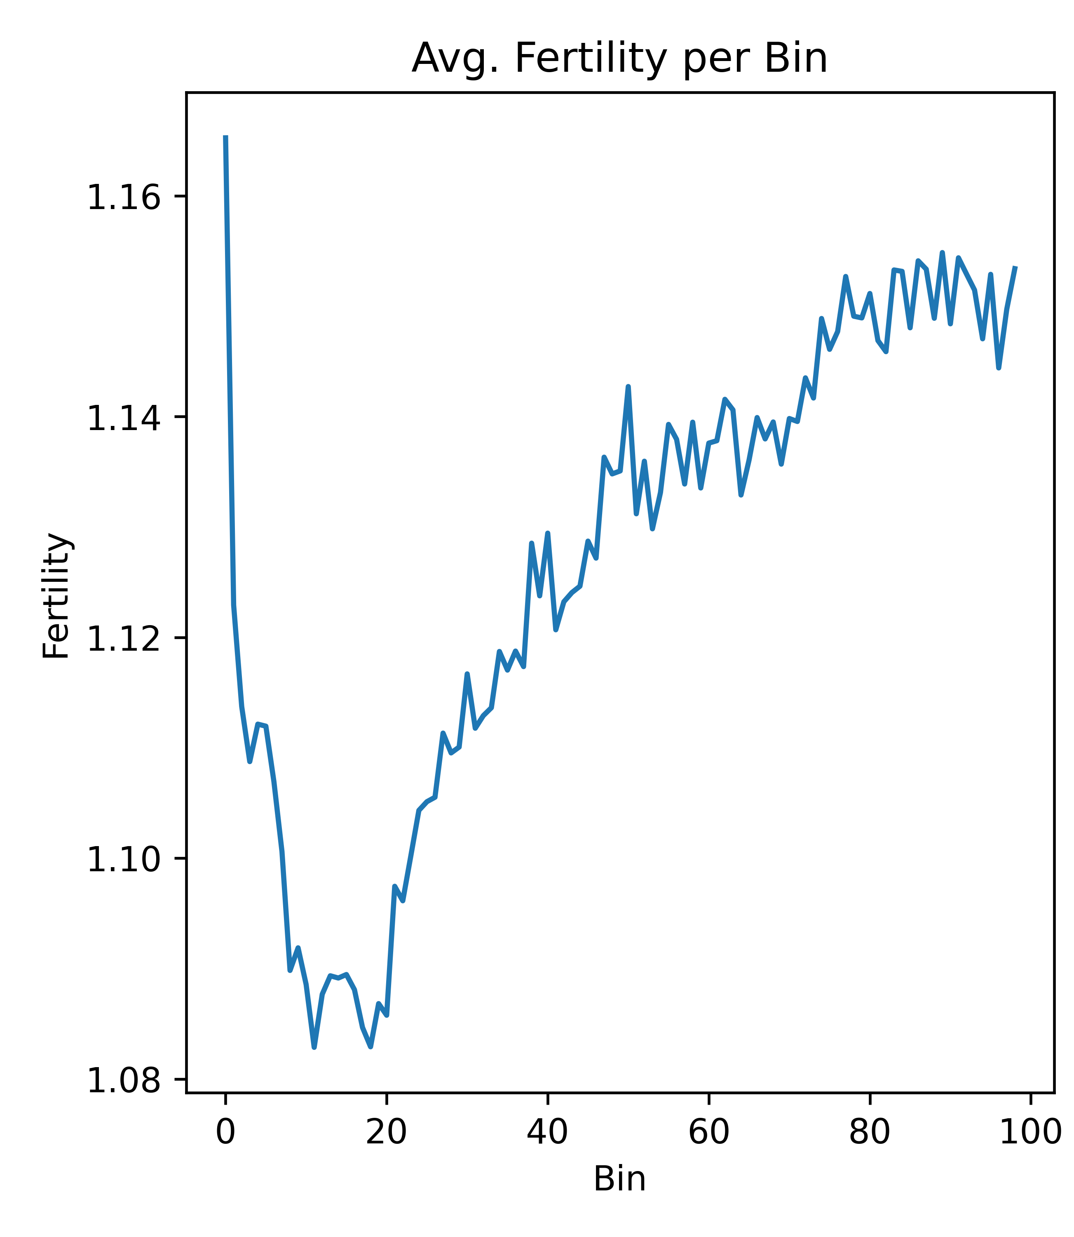
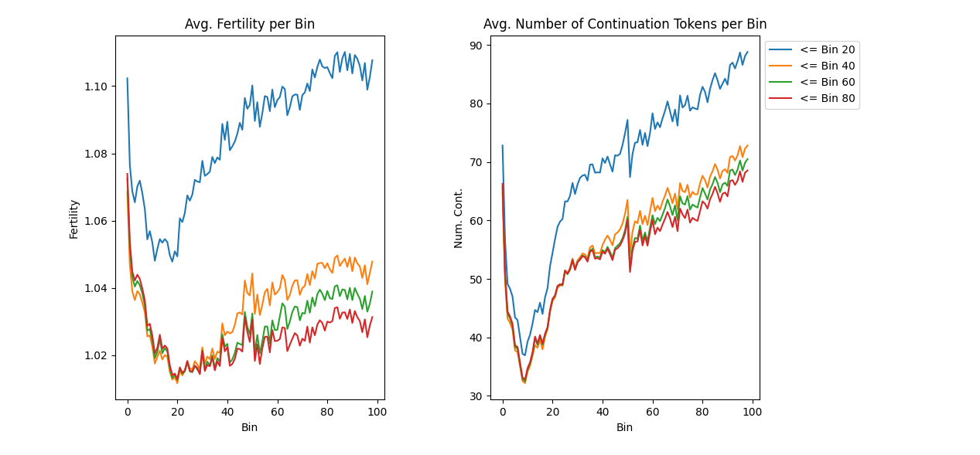
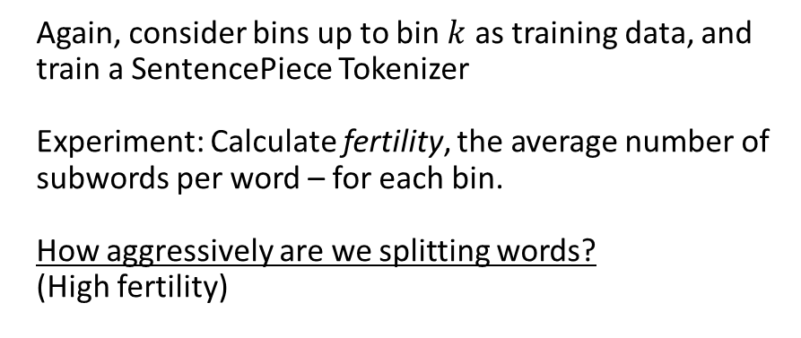
Subword Tokenizers over Time: Fertility
Again, consider bins up to bin $k$ as training data, and train a SentencePiece Tokenizer
Experiment: Calculate fertility, the average number of subwords per word – for each bin.
How aggressively are we splitting words?
(High fertility)
Fertility is increasing over time

Slide 40
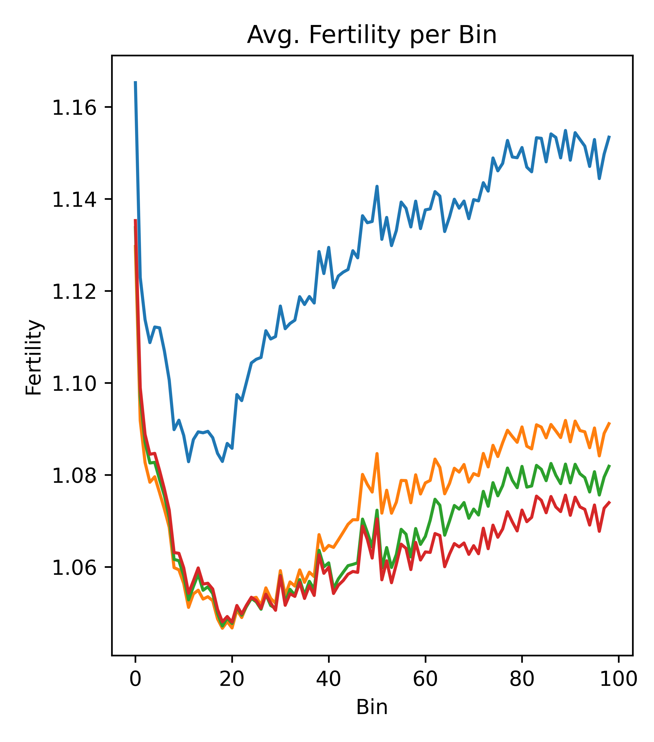
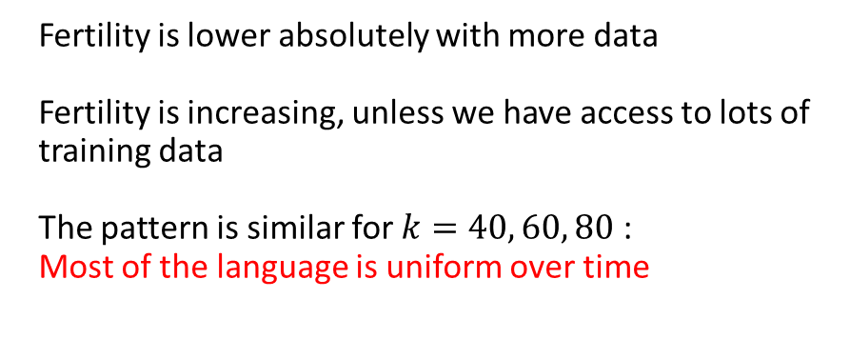
Subword Tokenizers over Time: Fertility
Again, consider bins up to bin $k$ as training data, and train a SentencePiece Tokenizer
Experiment: Calculate fertility, the average number of subwords per word – for each bin.
How aggressively are we splitting words?
(High fertility)
Fertility is lower absolutely with more data
Fertility is increasing, unless we have access to lots of training data
The pattern is similar for $k=40, 60, 80$ :
Most of the language is uniform over time

Slide 41

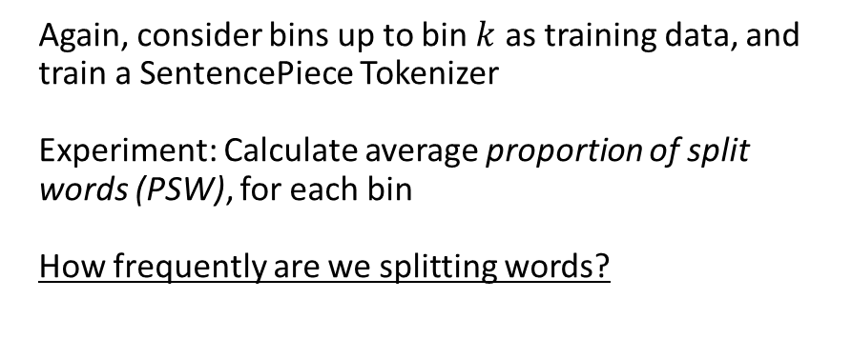
Subword Tokenizers over Time: PSW
Again, consider bins up to bin $k$ as training data, and train a SentencePiece Tokenizer
Experiment: Calculate average proportion of split words (PSW), for each bin
How frequently are we splitting words?
PSW is consistently increasing over time

Slide 42
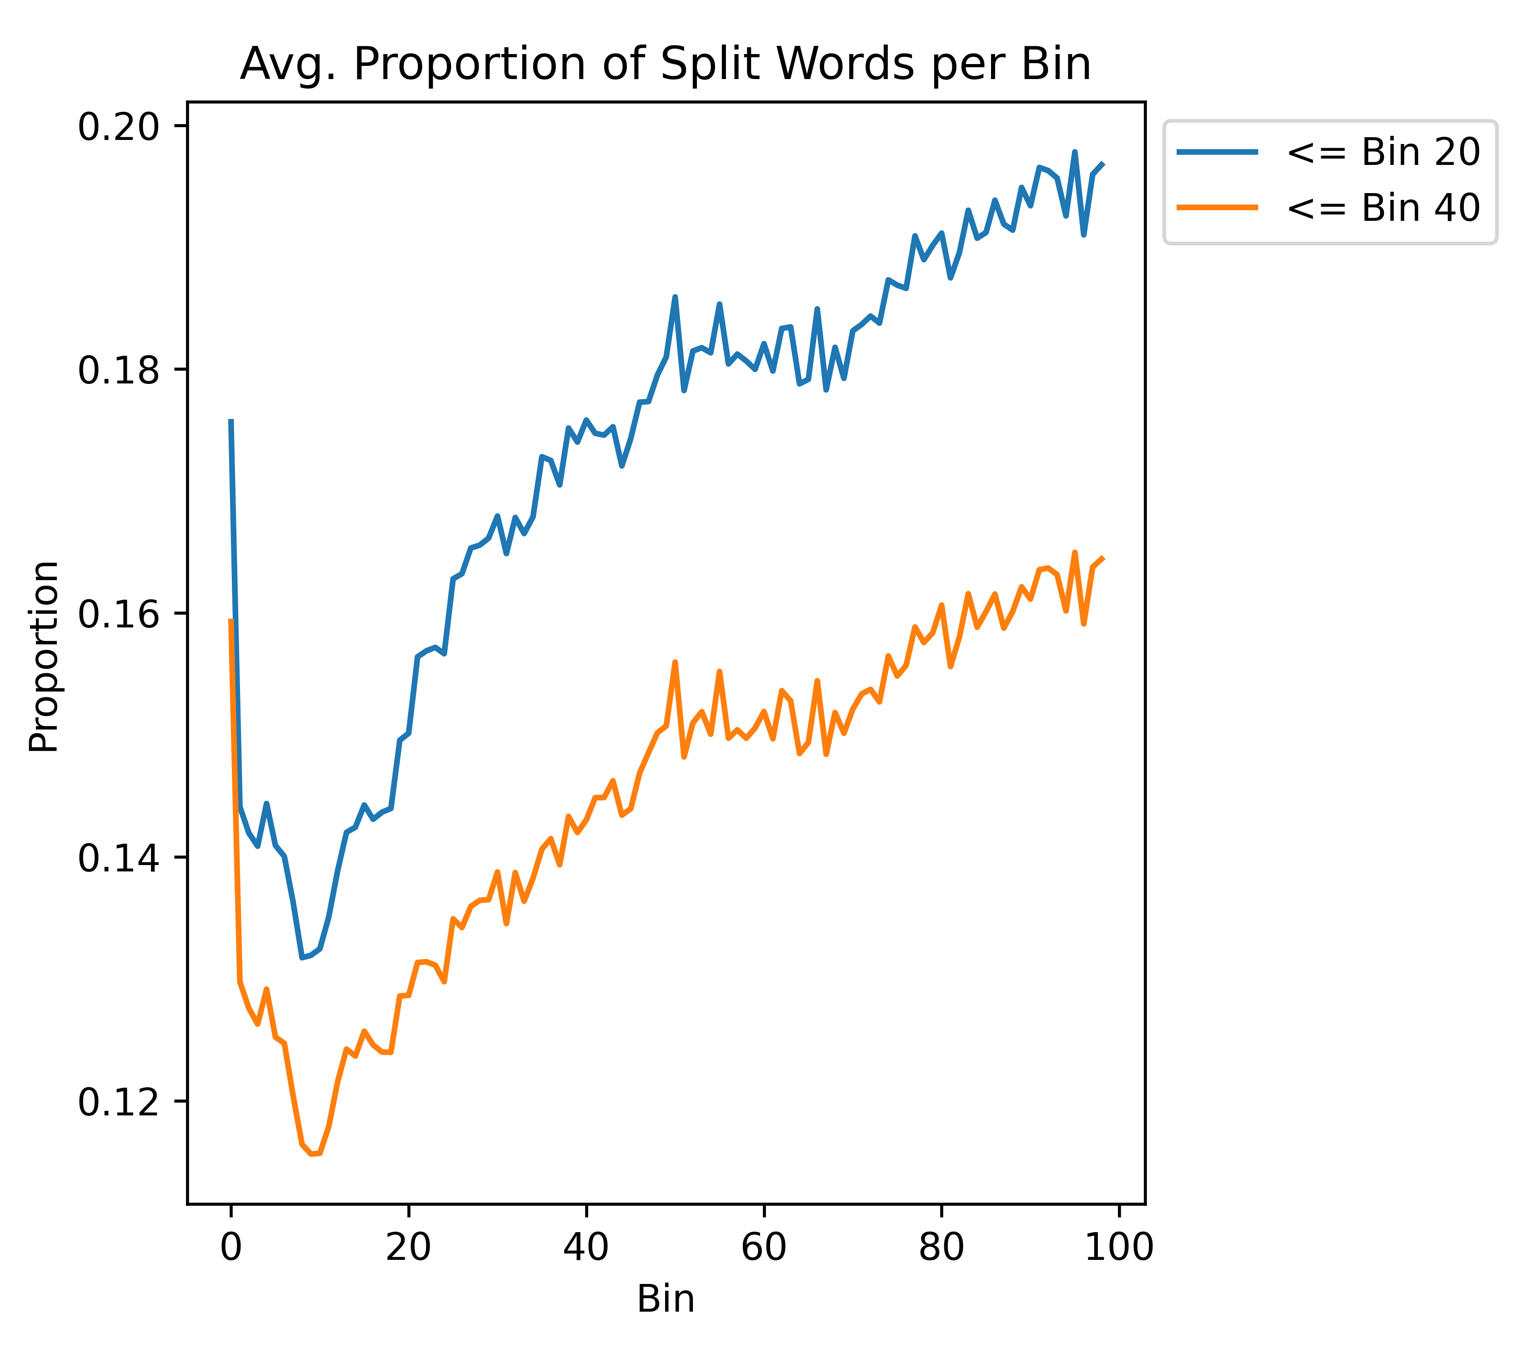
Subword Tokenizers over Time: PSW
Again, consider bins up to bin $k$ as training data, and train a SentencePiece Tokenizer
Experiment: Calculate average proportion of split words (PSW), for each bin
How frequently are we splitting words?
PSW is consistently increasing over time

Slide 43

Subword Tokenizers over Time: PSW
Again, consider bins up to bin $k$ as training data, and train a SentencePiece Tokenizer
Experiment: Calculate average proportion of split words (PSW), for each bin
How frequently are we splitting words?
PSW is consistently increasing over time
Training on more data doesn’t help
Models will have to handle new vocabulary words
Vocabulary size must increase to preserve good representations

Slide 44
Summary
Perplexity is predictable from bin to bin and has structure across time
Shown that the scientific literature is multilingual, while our models are not
Large effect on the perplexity, and representation for non-Latin script languages will be effectively random
RQ1: This effect varies across time
Shown that while the language of the text may be consistent, new terms are constantly appearing
RQ2: Language models will likely need to be updated to handle these new terms, both in terms of additional training as well vocabulary adaptation
Better Together: A scientific paper’s text can give important and fine-grained information on its content, but only if we can accurately encode it.
The majority of papers will present challenges towards this encoding. In most of these cases, the citation graph will be able to fill in the gaps.

Slide 45

Better Together

Slide 46
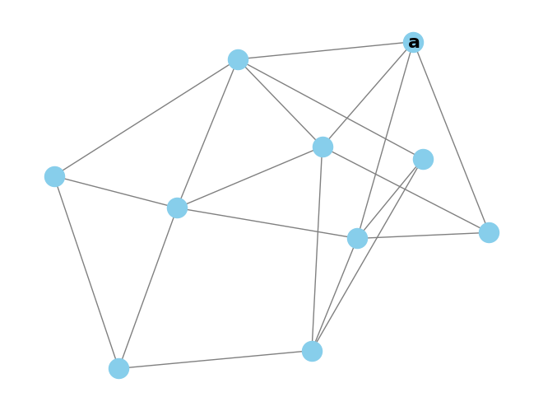
Intrinsic Evaluation - Random Walk Classification
Randomly pick start paper a

Slide 47
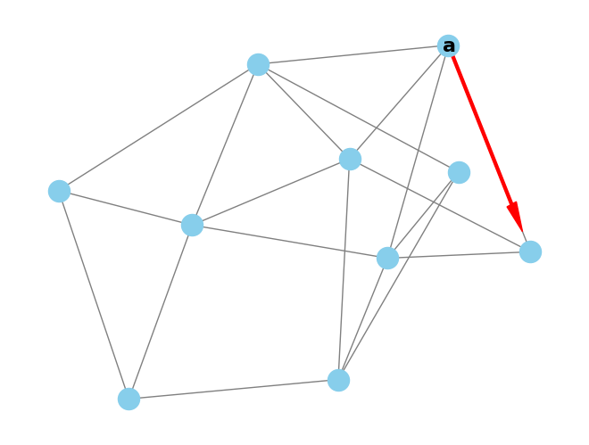
Intrinsic Evaluation - Random Walk Classification
Randomly pick start paper a
Jump to any referenced or citing paper

Slide 48
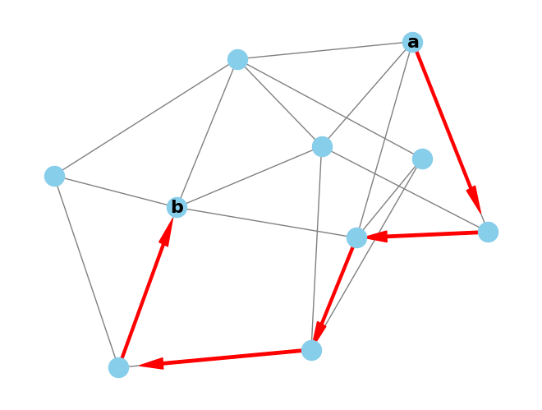
Intrinsic Evaluation - Random Walk Classification
Randomly pick start paper a
Jump to any referenced or citing paper
Repeat to reach final paper b

Slide 49
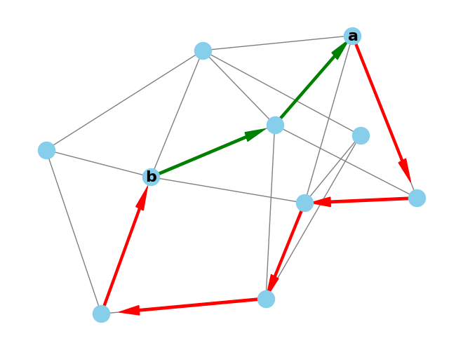
Intrinsic Evaluation - Random Walk Classification
Randomly pick start paper a
Jump to any referenced or citing paper
Repeat to reach final paper b
Verify the shortest path between a and b is in [1,4]
= 2-hop

Slide 50
Intrinsic Evaluation - Random Walk Classification
Randomly pick start paper a
Jump to any referenced or citing paper
Repeat to reach final paper b
Verify the shortest path between a and b is in [1,4]
It’s cheap to collect these of random walks, we have 3M
Hypothesis: representation models should have higher similarity for 1 hop than 2-4 hops.

Slide 51
Intrinsic Evaluation - Random Walk Forecasting
Can assign walks to bins for forecast evaluation
Walk bin = max(bin(a), bin(b))
Given the ProNE trained models, how well can they:
Remember from train (bin<=train split)
Predict the future (bin>train split)
Does this get harder as bin >> train split?

Slide 52
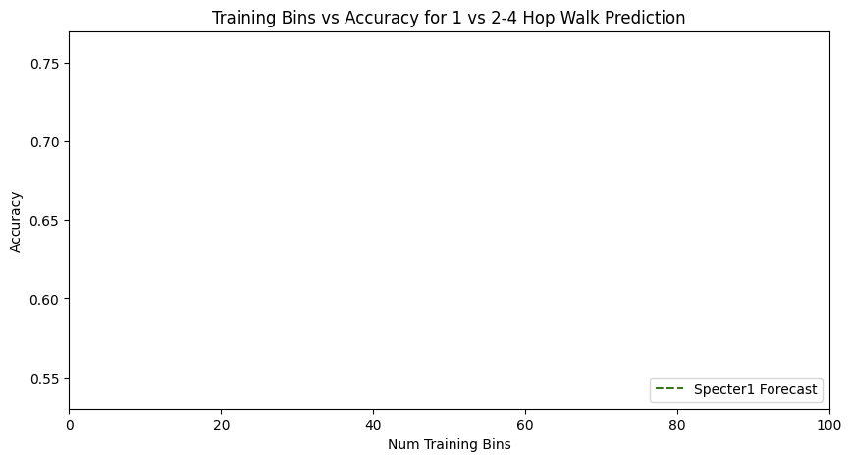
Forecasting with Text

Slide 53
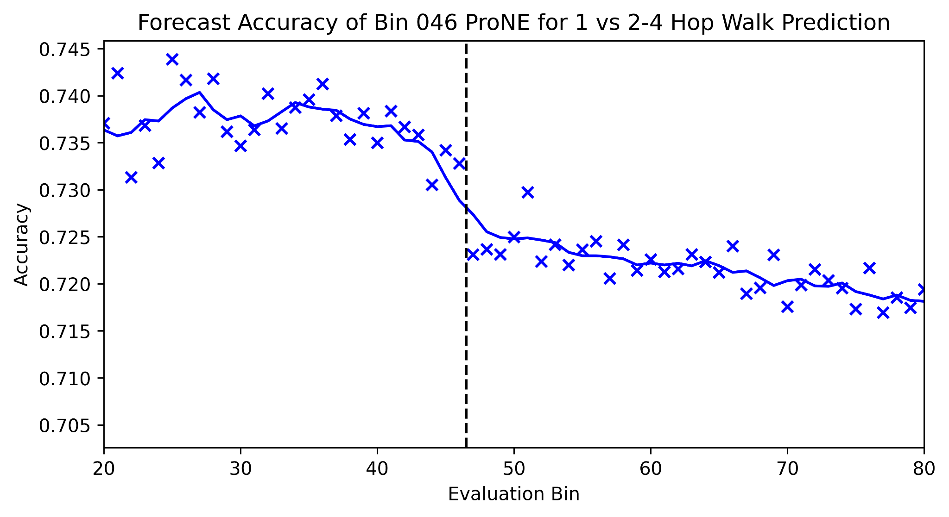
Forecasting from Bin 46

Slide 54
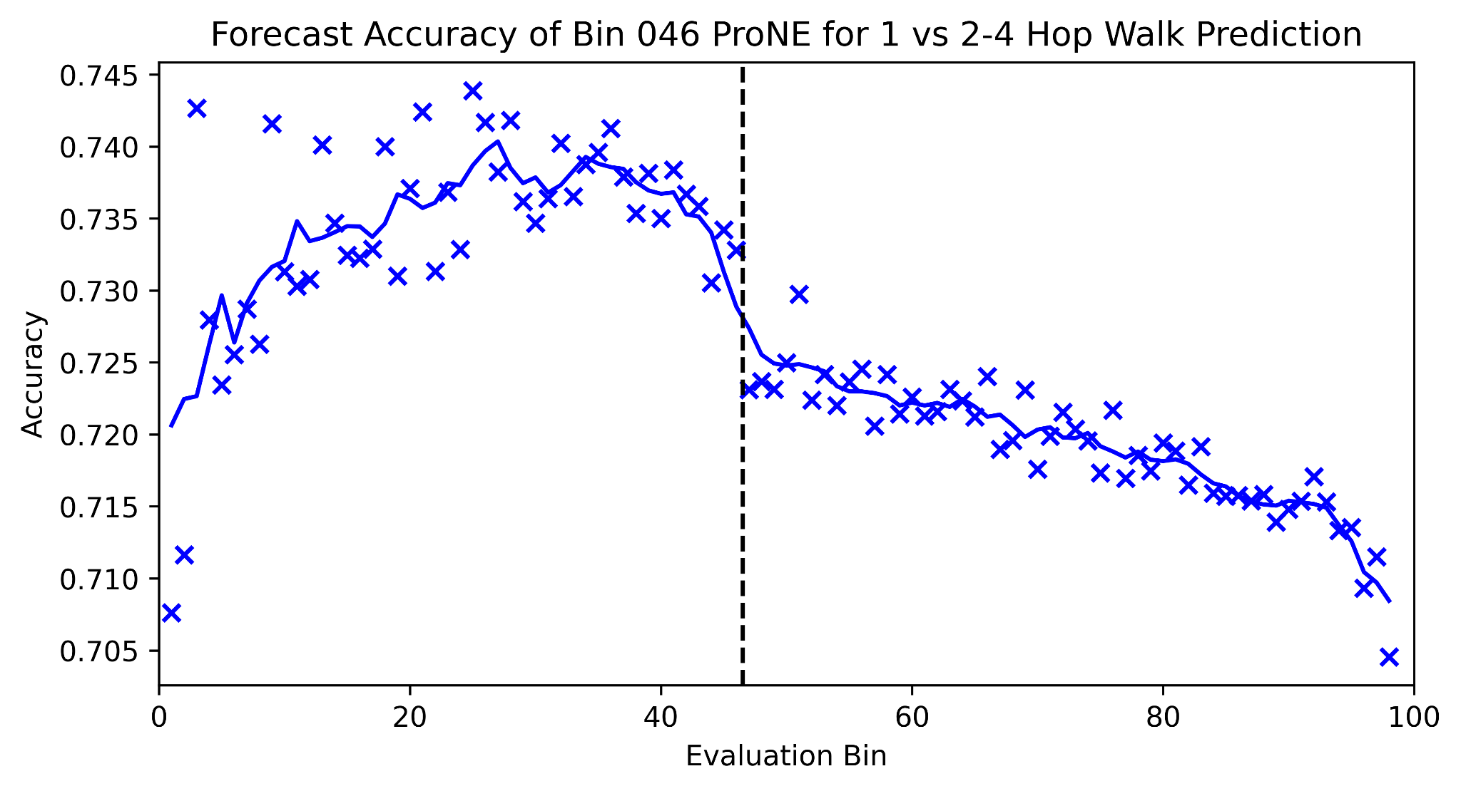
Forecasting from Bin 46 - Full Picture

Slide 55
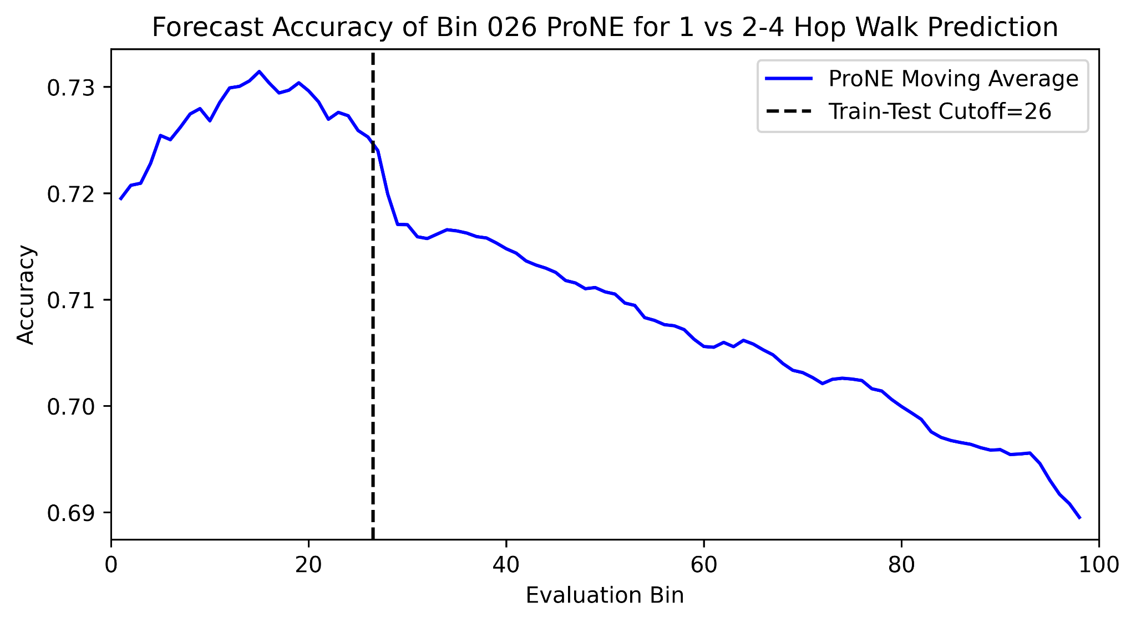
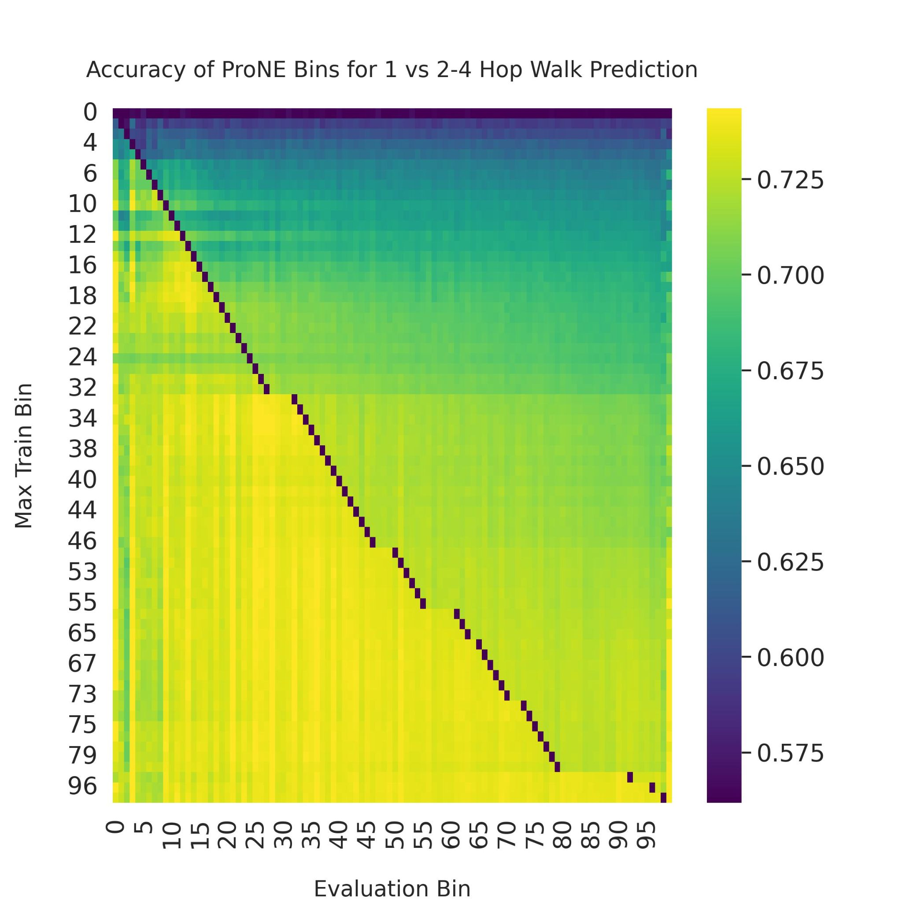
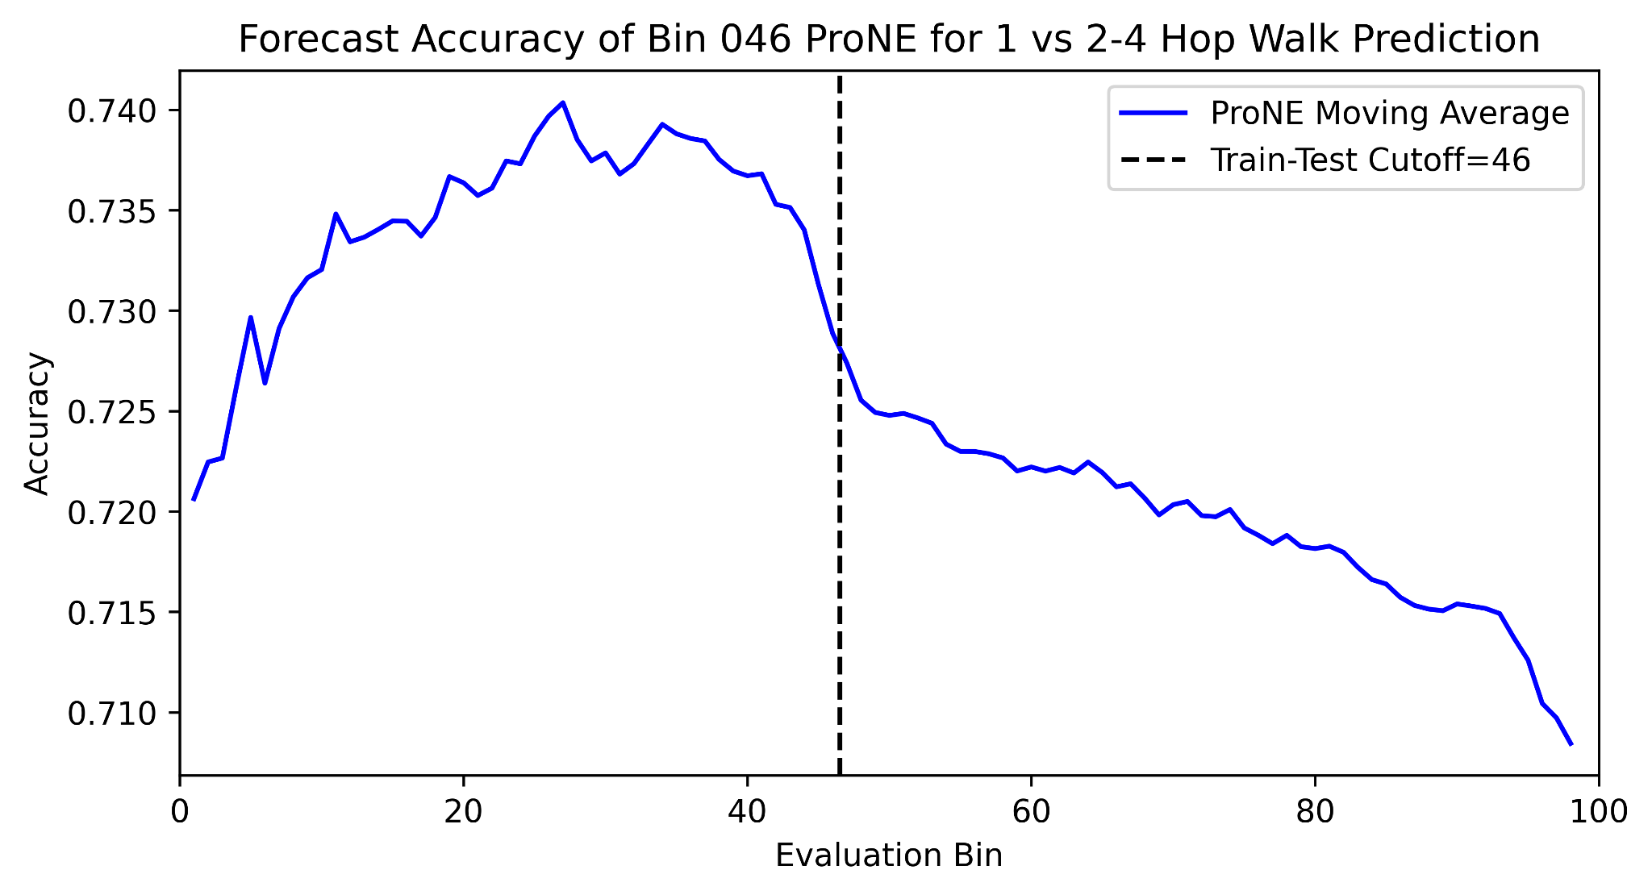
Forecasting for all Train-Test Splits
Forecasting Further
Hard
Easy

Slide 56
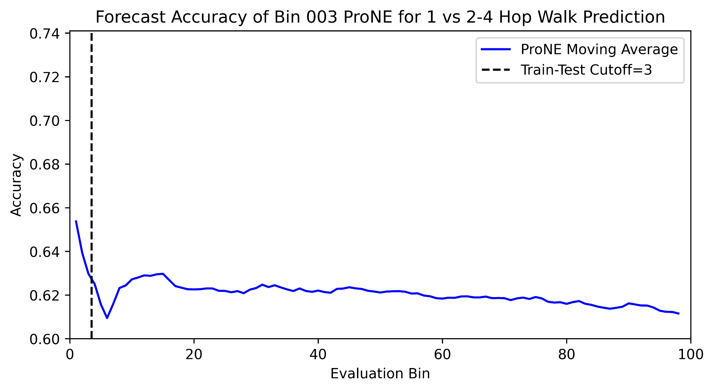
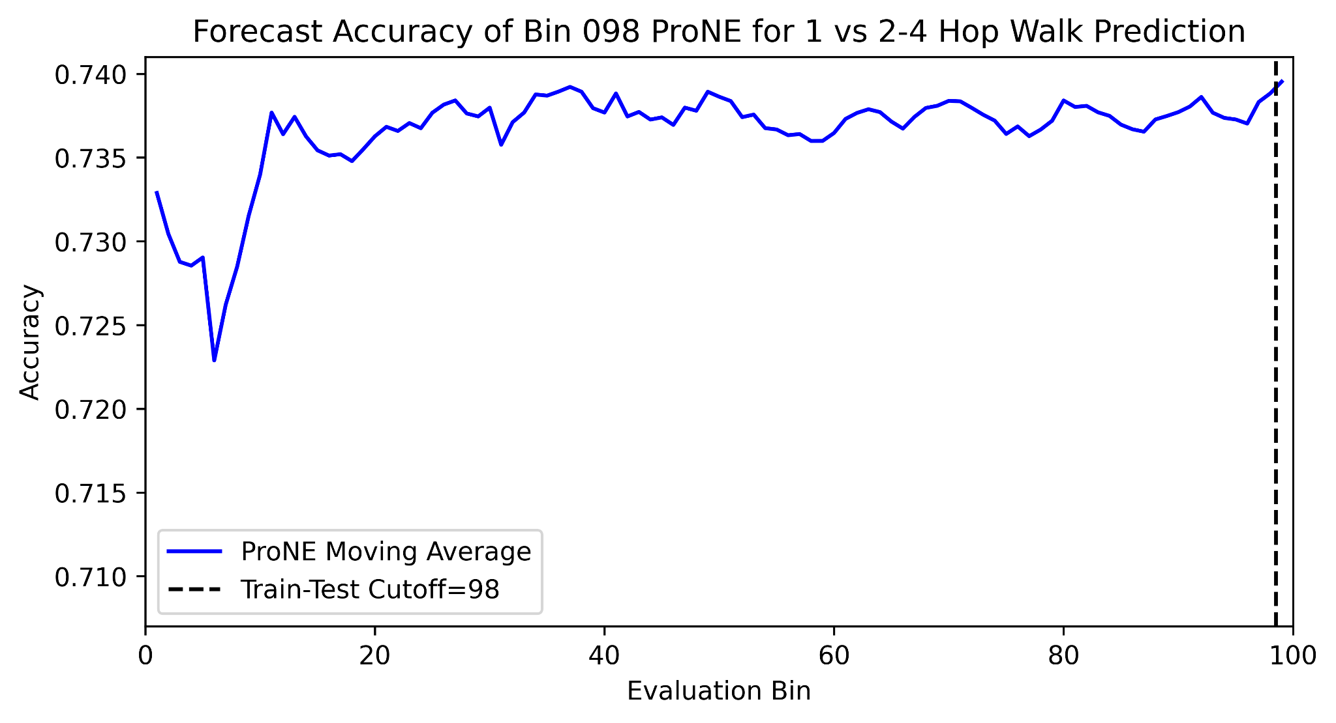
Forecasting for all Train-Test Splits - Extremes
Hard
Easy

Slide 57
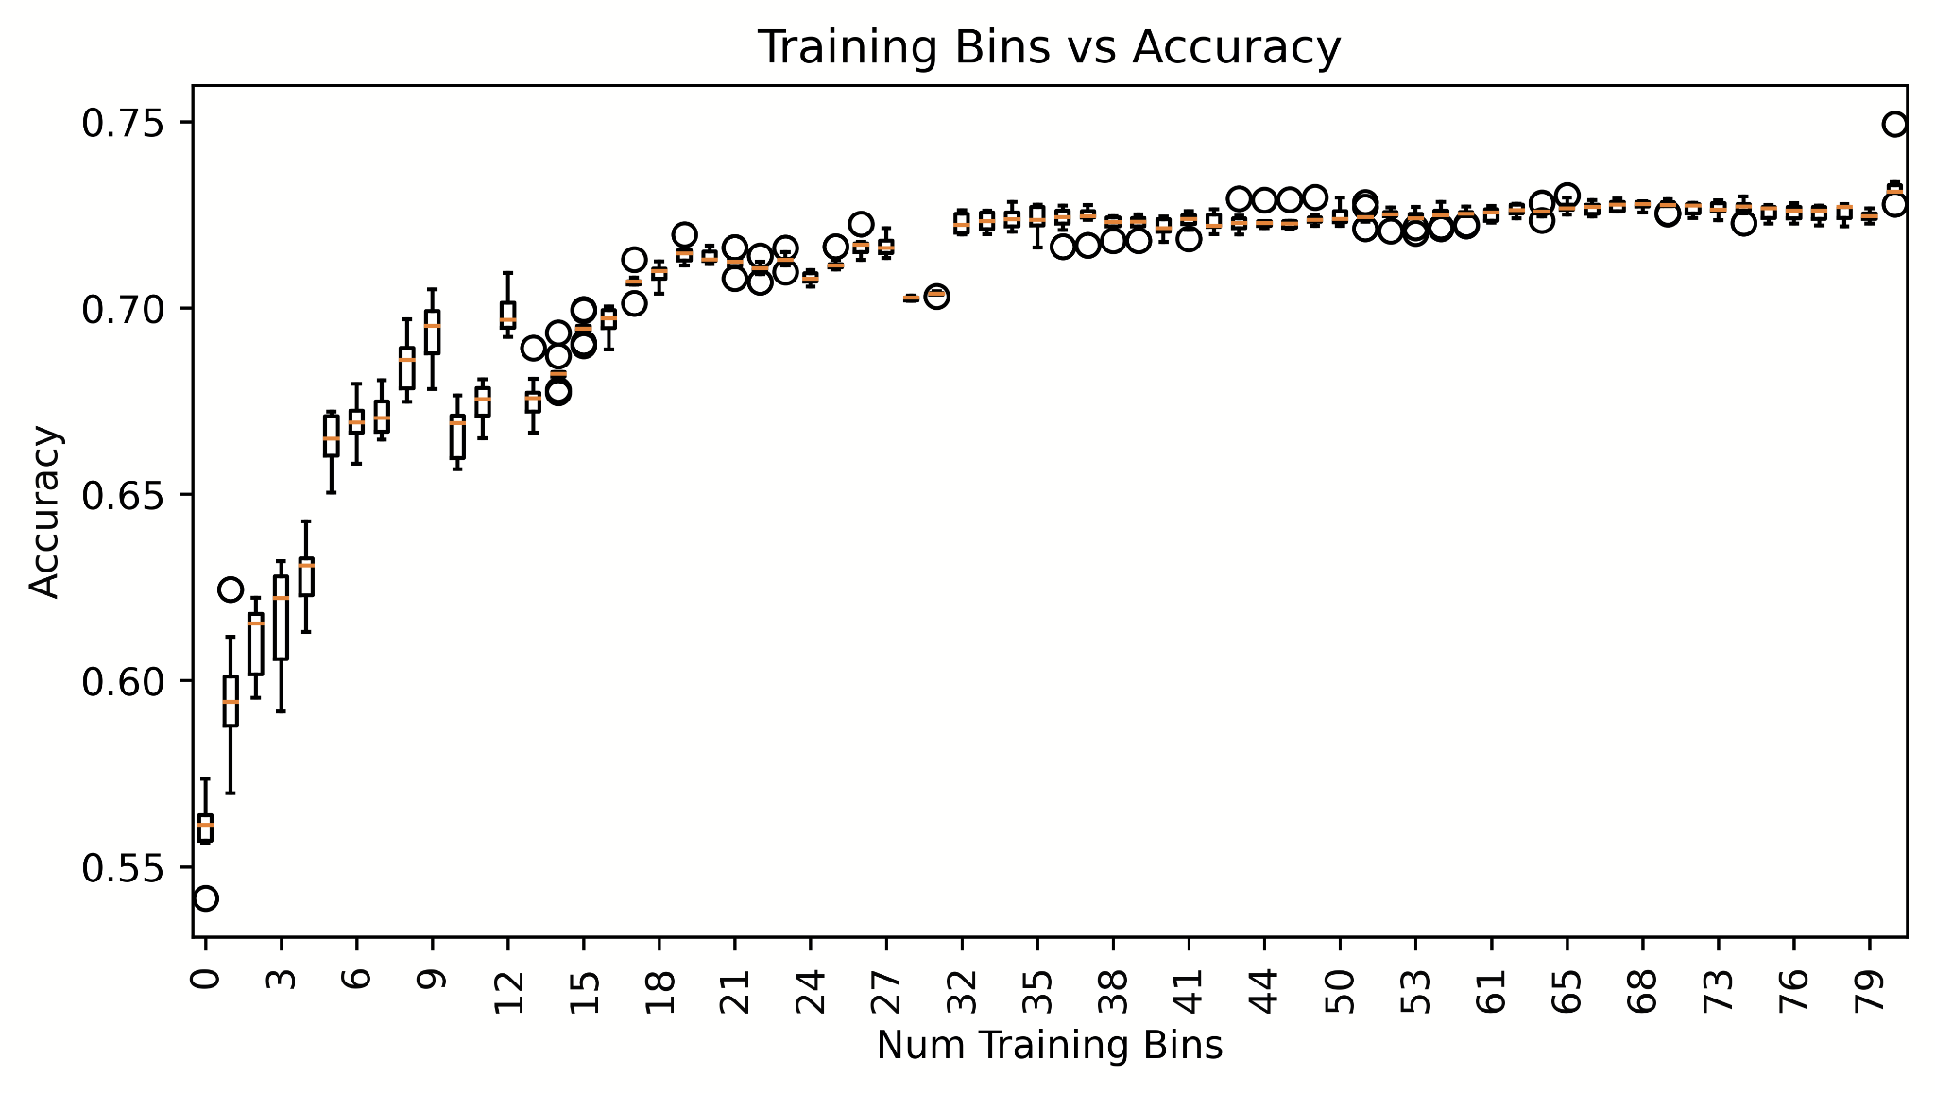
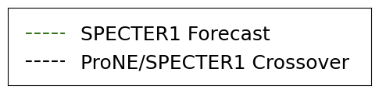
Training Size vs Forecast Ability

Slide 58
Training Size vs Forecast Ability
Context > Text: Metcalfe’s Law!

Slide 59
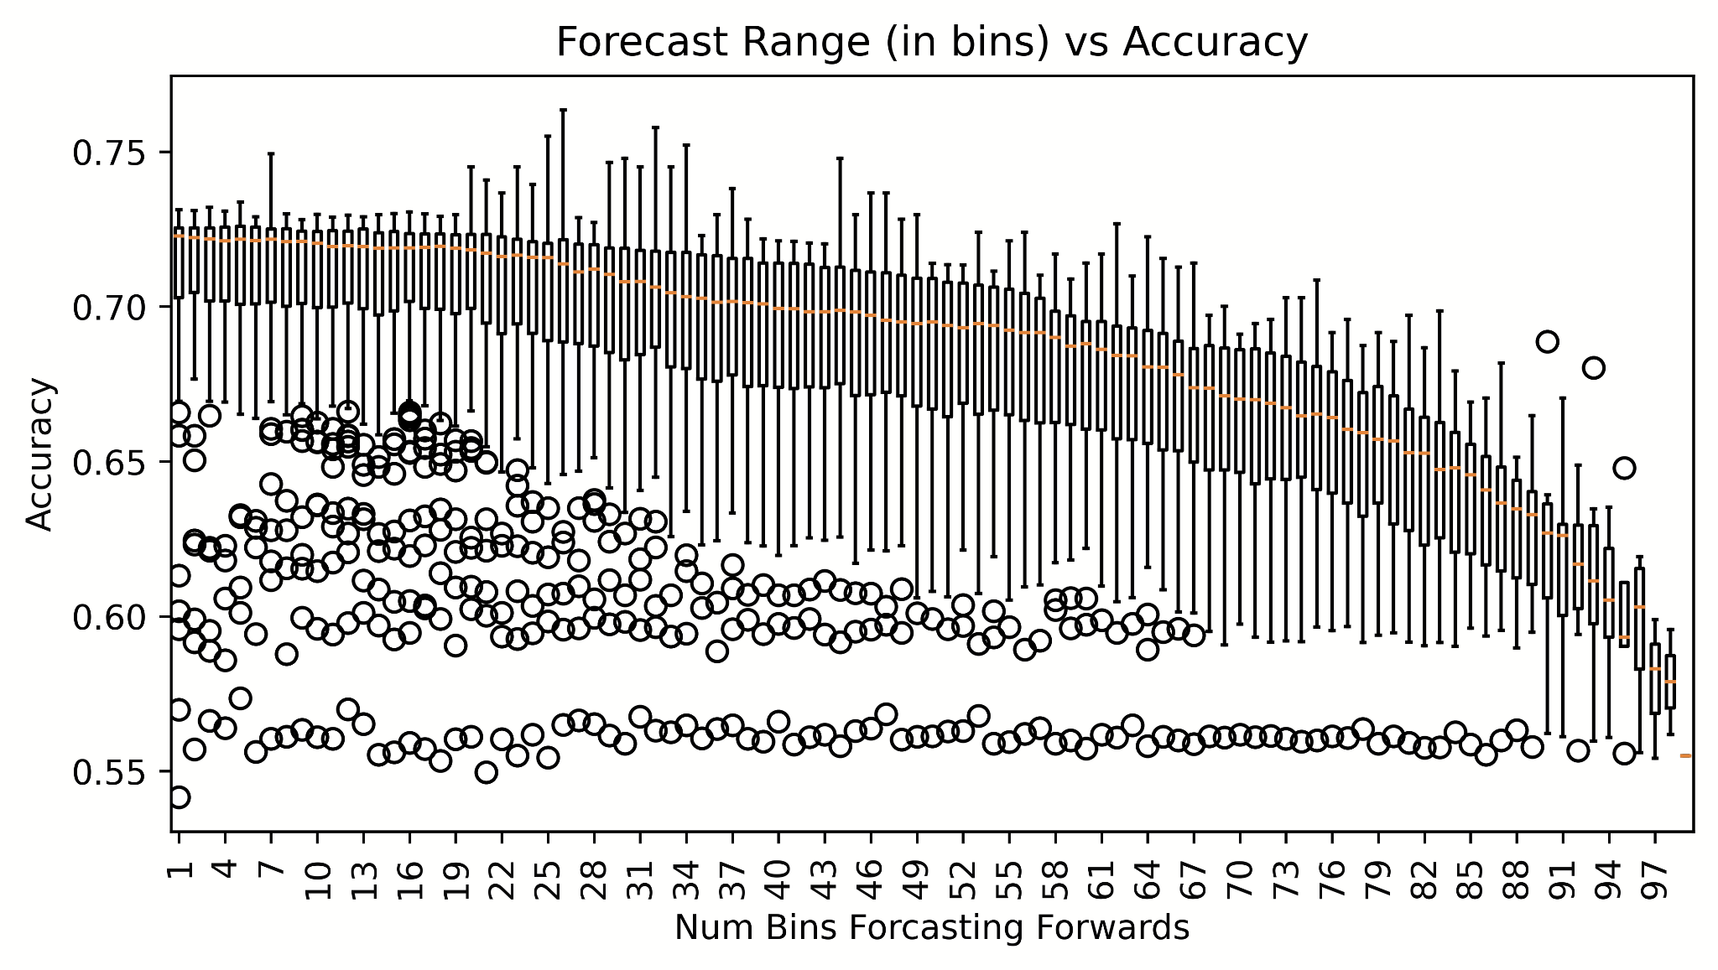
Forecast Distance vs Accuracy
Short-range Forecasting
Long-range Forecasting

Slide 60
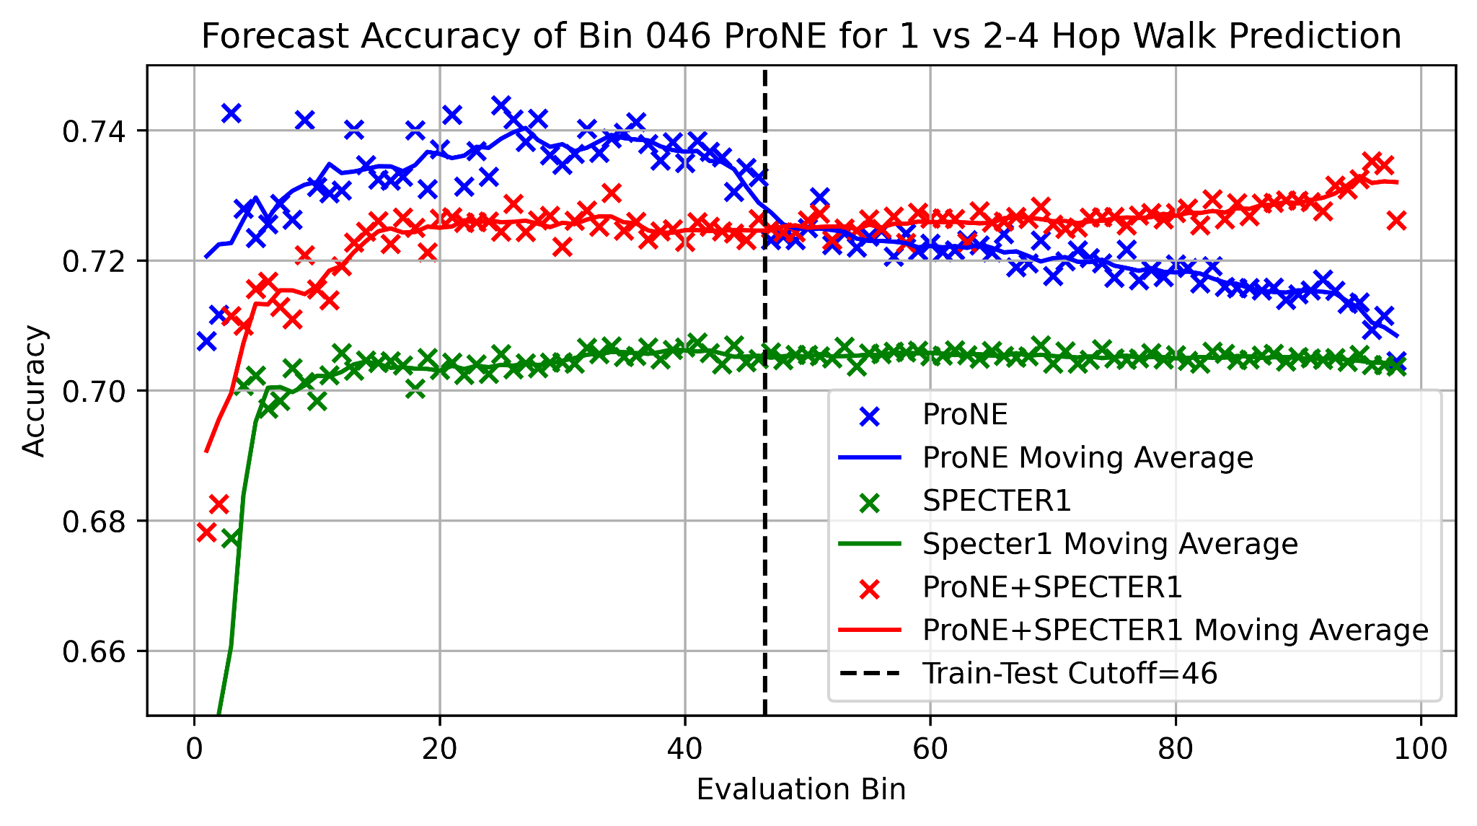
Text, Context, and Better Together

Slide 61
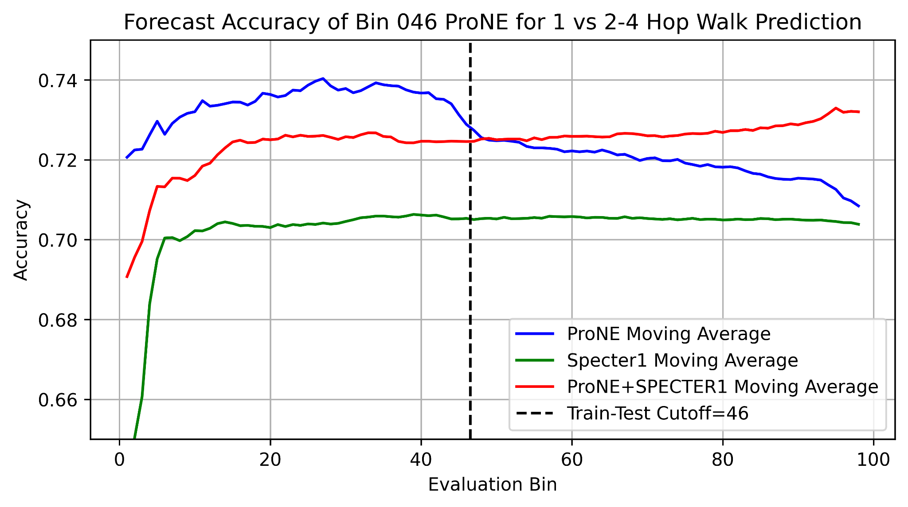
Text, Context, and Better Together

Slide 62
Intrinsic Evaluation - Random Walk Classification
Conclusions:
Context works: ProNE model is effective for modelling document links

Slide 63
Intrinsic Evaluation - Random Walk Classification
Conclusions:
Context works: ProNE model is effective for modelling document links
A large (50M+) train collection is required to get the best out of ProNE
Working with scale is required (Metcalfe's Law)
At lower scales, text is better

Slide 64
Intrinsic Evaluation - Random Walk Classification
Conclusions:
Context works: ProNE model is effective for modelling document links
A large (50M+) train collection is required to get the best out of ProNE
Working with scale is required (Metcalfe's Law)
At lower scales, text is better
Forecasting gets harder as we move out from the training set
Models are always rotting, incremental updates are needed

Slide 65
Intrinsic Evaluation - Random Walk Classification
Conclusions:
Context works: ProNE model is effective for modelling document links
A large (50M+) train collection is required to get the best out of ProNE
Working with scale is required (Metcalfe's Law)
At lower scales, text is better
Forecasting gets harder as we move out from the training set
Models are always rotting, incremental updates are needed
Text is a baseline, can use as a fallback to further improve performance
Text+Context: Better Together!

Slide 66
Extrinsic Evaluation – Local Citation Recommendation
Citation Recommendation = ‘What should I cite?’
Local Citation Recommendation = ‘What should I cite here in the document?’
Established task, many datasets (FullTextPeerRead 10K - RefSeer 3M samples)
We create our own task from full text Semantic Scholar Data (S2ORC)
Every citing sentence (400M) is a data point (400M samples)
Any Full-text paper in S2ORC (12M) is a valid source
Any paper is Semantic Scholar (200M) is a valid target

Slide 67
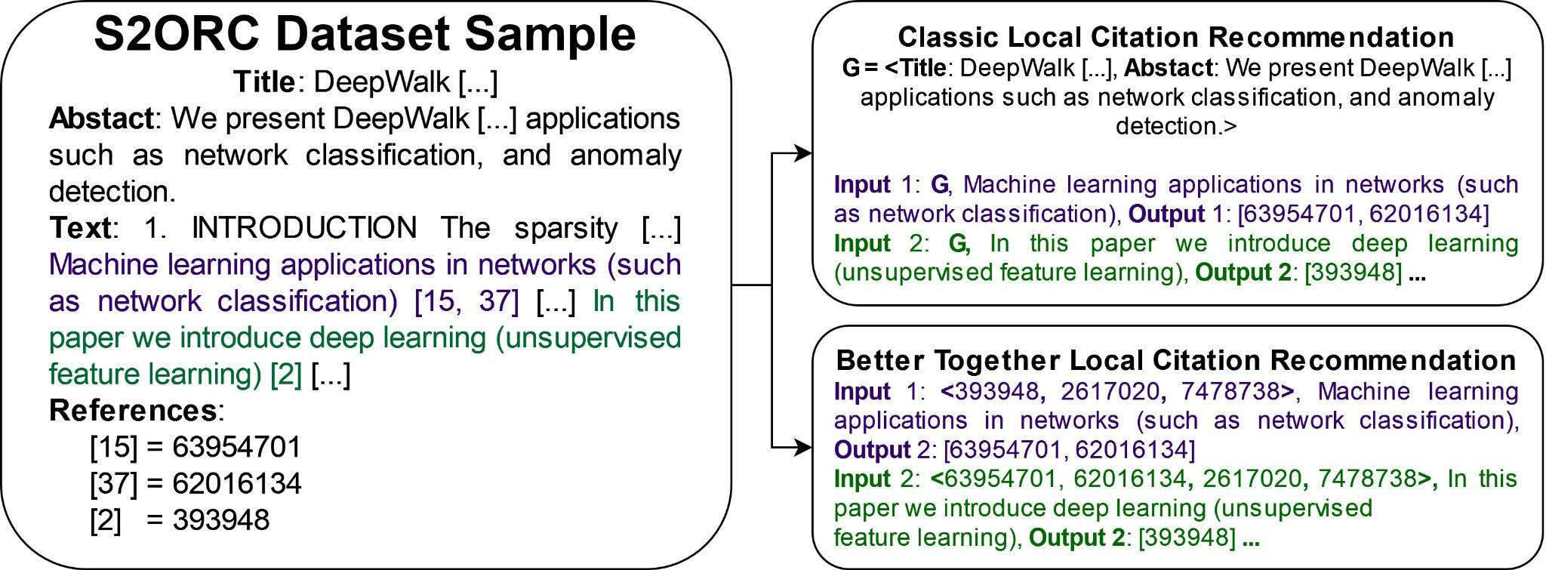
Local Citation Recommendation Format
Notes:
Refer to original paper before this. Link prediction refers to many things – earlier was one of simpler ones, whether i cites j. Introducing more complex problem
Reduce text
? answer, not q
use animations?
Emphasize task as predicting citations associated with citing sentence

Slide 68
Local Citation Recommendation Methods
Text-based Search
Citing Sentences
Embeddings of the citing sentence -> citing sentences, return their target id
Title+Citing Sentence
Embeddings of the title+citing sentence -> other titles and abstracts, return their id
Title+Abstract
Embeddings of the title+abstract -> other titles and abstracts, return their id
Citing Sentences
Author: Alan Turing
Title: “On Computable Numbers”
Abstract: “The 'computable' numbers may be described briefly as [...]”
Often cited as ‘Turing Machine [paper]’ - but Turing never used those words

Slide 69
Local Citation Recommendation Methods
Reference-based Search
Source
ProNE embeddings of the source document -> ProNE embeddings of the target document
‘Centroid Method’
Average of ProNE embeddings of other references -> ProNE embeddings of the target document
Weighted ‘Centroid Method’
Distance-weighted average of ProNE embeddings of other references -> ProNE embeddings of the target document

Slide 70
Local Citation Recommendation Methods
Text-based Search
Citing Sentences
Embeddings of the citing sentence -> citing sentences, return their target id
Title+Citing Sentence
Embeddings of the title+citing sentence -> other titles and abstracts, return their id
Title+Abstract
Embeddings of the title+abstract -> other titles and abstracts, return their id
Reference-based Search
Source
ProNE embeddings of the source document -> ProNE embeddings of the target document
‘Centroid Method’
Average of ProNE embeddings of other references -> ProNE embeddings of the target document
Weighted ‘Centroid Method’
Distance-weighted average of ProNE embeddings of other references -> ProNE embeddings of the target document

Slide 71
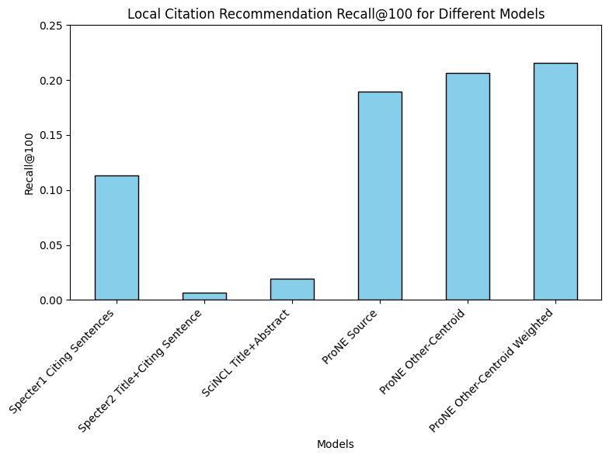
Local Citation Recommendations - Text vs Context R@100
Model | R@100
Specter1 Citing Sentences | 0.1133
Specter2 Title+Citing Sentence | 0.0067
SciNCL Title+Abstract | 0.0194
ProNE Source | 0.1898
ProNE Other-Centroid | 0.2068
ProNE Other-Centroid Weighted | 0.2156

Slide 72
Local Citation Recommendations - Text vs Context R@100
Model | R@100
Specter1 Citing Sentences | 0.1133
Specter2 Title+Citing Sentence | 0.0067
SciNCL Title+Abstract | 0.0194
ProNE Source | 0.1898
ProNE Other-Centroid | 0.2068
ProNE Other-Centroid Weighted | 0.2156

Slide 73
Local Citation Recommendations - Text vs Context R@100
Model | R@100
Specter1 Citing Sentences | 0.1133
Specter2 Title+Citing Sentence | 0.0067
SciNCL Title+Abstract | 0.0194
ProNE Source | 0.1898
ProNE Other-Centroid | 0.2068
ProNE Other-Centroid Weighted | 0.2156

Slide 74
Local Citation Recommendations - Text vs Context R@100
Model | R@100
Specter1 Citing Sentences | 0.1133
Specter2 Title+Citing Sentence | 0.0067
SciNCL Title+Abstract | 0.0194
ProNE Source | 0.1898
ProNE Other-Centroid | 0.2068
ProNE Other-Centroid Weighted | 0.2156

Slide 75
Local Citation Recommendations - Text vs Context R@100
Model | R@100
Specter1 Citing Sentences | 0.1133
Specter2 Title+Citing Sentence | 0.0067
SciNCL Title+Abstract | 0.0194
ProNE Source | 0.1898
ProNE Other-Centroid | 0.2068
ProNE Other-Centroid Weighted | 0.2156

Slide 76
Local Citation Recommendations - Text vs Context R@100
Model | R@100
Specter1 Citing Sentences | 0.1133
Specter2 Title+Citing Sentence | 0.0067
SciNCL Title+Abstract | 0.0194
ProNE Source | 0.1898
ProNE Other-Centroid | 0.2068
ProNE Other-Centroid Weighted | 0.2156

Slide 77
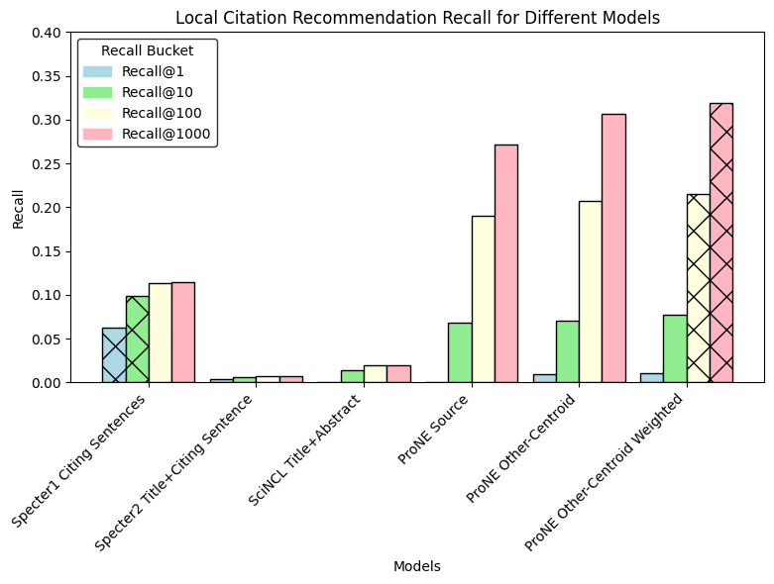
Local Citation Recommendations - Text Vs Context
Model | R@1 | R@10 | R@100 | R@1000
Specter1 Citing Sentences | 0.0622 | 0.0988 | 0.1133 | 0.1141
Specter2 Title+Citing Sentence | 0.0033 | 0.0059 | 0.0067 | 0.0067
SciNCL Title+Abstract | 0.0004 | 0.0143 | 0.0194 | 0.0194
ProNE Source | 0.0005 | 0.0684 | 0.1898 | 0.2717
ProNE Other-Centroid | 0.0093 | 0.0705 | 0.2068 | 0.3068
ProNE Other-Centroid Weighted | 0.0100 | 0.0771 | 0.2156 | 0.3195

Slide 78
Local Citation Recommendations - Text Vs Context
Model | R@1 | R@10 | R@100 | R@1000
Specter1 Citing Sentences | 0.0622 | 0.0988 | 0.1133 | 0.1141
Specter2 Title+Citing Sentence | 0.0033 | 0.0059 | 0.0067 | 0.0067
SciNCL Title+Abstract | 0.0004 | 0.0143 | 0.0194 | 0.0194
ProNE Source | 0.0005 | 0.0684 | 0.1898 | 0.2717
ProNE Other-Centroid | 0.0093 | 0.0705 | 0.2068 | 0.3068
ProNE Other-Centroid Weighted | 0.0100 | 0.0771 | 0.2156 | 0.3195

Slide 79
Local Citation Recommendations - Conclusions
Reference Recommendation at the 200M paper scale is possible but hard

Slide 80
Local Citation Recommendations - Conclusions
Reference Recommendation at the 200M paper scale is possible but hard
Citing sentences are a great signal - but incomplete
We get the information quickly (@10, then nothing more)
Recall@10 0.099, Recall@100 0.113 (+0.014)

Slide 81
Local Citation Recommendations - Conclusions
Reference Recommendation at the 200M paper scale is possible but hard
Citing sentences are a great signal - but incomplete
We get the information quickly (@10, then nothing more)
Recall@10 0.099, Recall@100 0.113 (+0.014)
As the intrinsic evaluation found, ProNE is very capable at link prediction
Gain less strong initially but continues down the retrieval list (@100, @1000)
Local weighting adds around 0.01
R@10 0.077, R@100 0.216 (+0.139) R@1000 0.320 (+0.104)

Slide 82
Local Citation Recommendations - Conclusions
Reference Recommendation at the 200M paper scale is possible but hard
Citing sentences are a great signal - but incomplete
We get the information quickly (@10, then nothing more)
Recall@10 0.099, Recall@100 0.113 (+0.014)
As the intrinsic evaluation found, ProNE is very capable at link prediction
Gain less strong initially but continues down the retrieval list (@100, @1000)
Local weighting adds around 0.01
R@10 0.077, R@100 0.216 (+0.139) R@1000 0.320 (+0.104)
Title+Abstracts alone are pretty weak
Future work: combine citing sentence and ProNE systems for recommendation

Slide 83
Document Time Period Prediction

Slide 84
Time Period Prediction – Task Overview
Given a query paper, predict the time period (time bin) it comes from
Input: single scientific paper
Embeddings: Specter, Specter 2, SciNCL, ProNE
References of query paper, along with information such as publication year
Similar documents to query paper
Map of year to time bin
Output: Predicted time bin
Bin 99
………
Bin 0
Time

Slide 85
Time Period Prediction – Motivation
Understand contribution of embedding types and nearest neighbors on predicting information about query paper
Detect missing or incorrect data
Many papers in dataset cannot be found in semantic scholar
Some papers are recorded to cite far into the future
Proxy for other tasks
Venue prediction
Field of study
Reviewer matching
Collaborator search
???

Slide 86
Time Period Prediction – Experiments Overview
Baseline – References
Semantic Scholar API
Similar Papers
Embeddings
ProNE: citations
Specter: text
Specter 2: text
SciNCL: text
Combination
Pairs of embeddings
•Embedding: M ∈ R^(N×K)
•N: ≈200M documents
•K: hidden dimensions
•Similarity of two docs: cos(i,j)⁡
•Similarity of all pairs of docs: MM^T

Slide 87
Time Period Prediction – Data
Bigrams:
Cosine similarity, query paper corpus ID, and list of similar papers to query
(0.9984, 4336316, 121417552)
(0.9970, 4336316, 15371799)
(0.9966, 4336316, 4239637)
(0.9953, 4336316, 117876280)

Slide 88
Time Period Prediction – Data
Bigrams:
Cosine similarity, query paper corpus ID, and list of similar papers to query
(0.9984, 4336316, 121417552)
(0.9970, 4336316, 15371799)
(0.9966, 4336316, 4239637)
(0.9953, 4336316, 117876280)

Slide 89
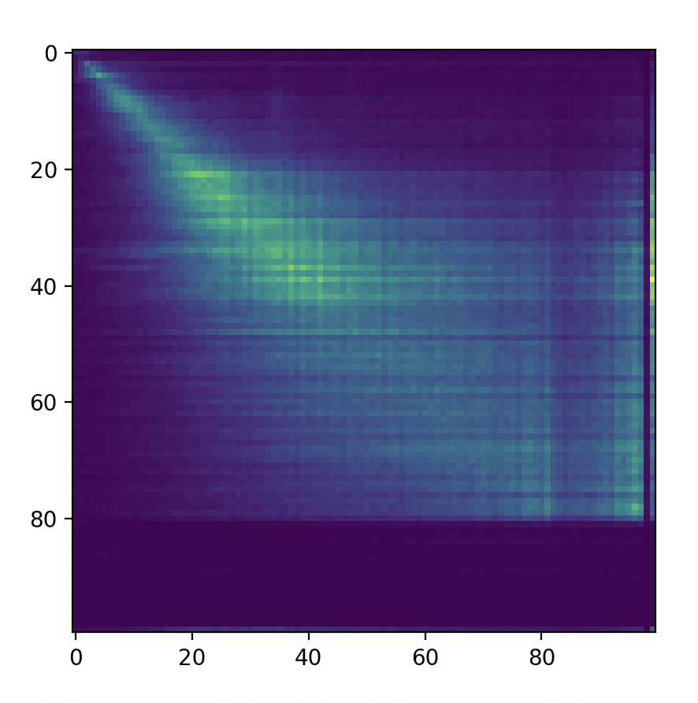
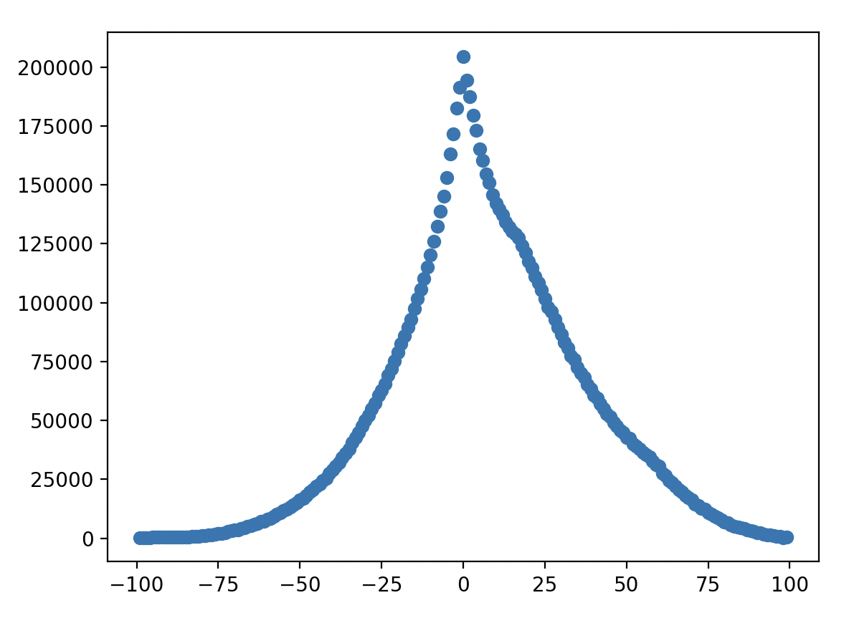
Time Period Prediction – Initial experiments
Count of Citations by Bin Number
Sum of Count of Citations at each Bin Offset
Paper 2 Bin
Count
Paper 1 Bin
Bin Offset

Slide 90
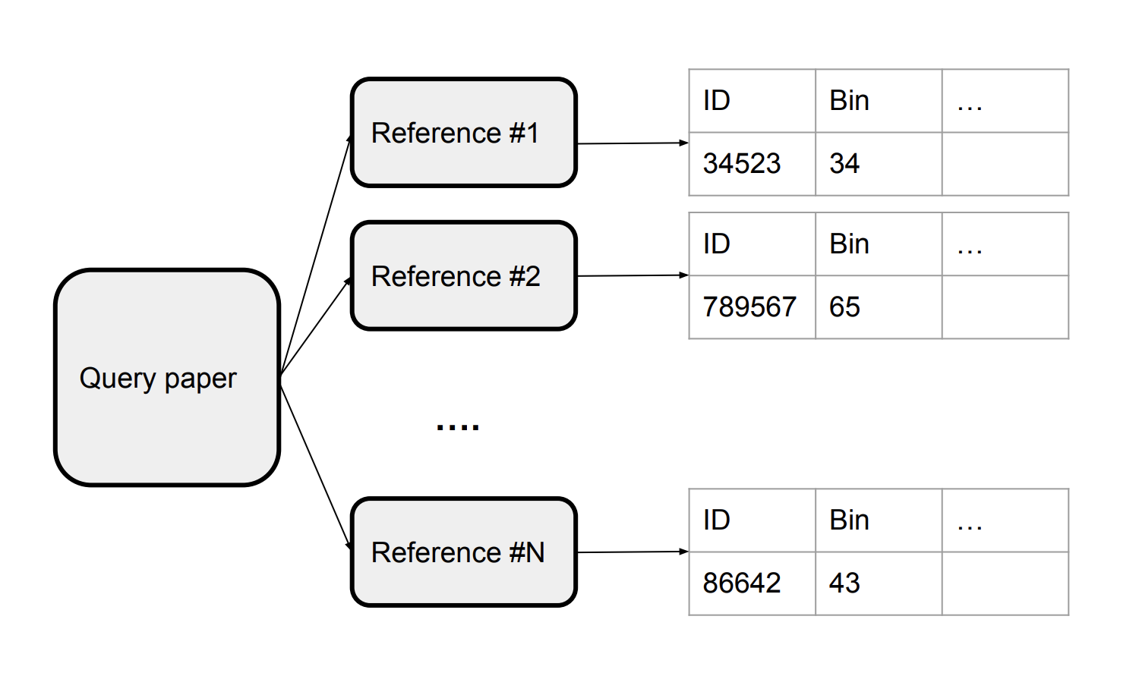
Time Period Prediction – Baseline
Use bin of most recent reference as predicted bin of query paper
Semantic Scholar API
max()

Slide 91
Time Period Prediction – Baseline Results
Method | Cumulative Acc | Accuracy | Precision | Recall | F1
Bin # of most recent reference | 18.80 | 18.80 | 0.21 | 0.19 | 0.19
Bin # of most recent reference + 1 | 39.25 | 20.45 | 0.23 | 0.20 | 0.21
Bin # of most recent reference + 2 | 52.33 | 13.08 | 0.14 | 0.13 | 0.13

Slide 92

Time Period Prediction – Similar Papers

Slide 93
Time Period Prediction – Similar Papers Results
Method | Accuracy | Precision | Recall | F1
Top 10 by cosine | 7.57 | 0.07 | 0.08 | 0.06
Top 5 by cosine | 7.51 | 0.07 | 0.08 | 0.06
Top 1 by cosine | 6.99 | 0.08 | 0.07 | 0.06

Slide 94

Time Period Prediction – Embeddings

Slide 95
Time Period Prediction – Embeddings Results
Method | Accuracy | Precision | Recall | F1
Specter | 49.87 | 0.48 | 0.50 | 0.48
Specter 2 | 41.23 | 0.39 | 0.41 | 0.39
SciNCL | 24.59 | 0.22 | 0.25 | 0.22
ProNE | 59.45 | 0.58 | 0.59 | 0.58

Slide 96

Time Period Prediction – Combinations

Slide 97
Time Period Prediction – Combinations

Slide 98
Time Period Prediction – Combinations Results
Method | Accuracy | Precision | Recall | F1
Specter 2 + Specter | 69.53 | 0.67 | 0.70 | 0.68
SciNCL + Specter 2 | 25.21 | 0.23 | 0.25 | 0.23
SciNCL + Specter | 60.59 | 0.58 | 0.61 | 0.58
ProNE + SciNCL | 67.81 | 0.66 | 0.68 | 0.66
ProNE + Specter 2 | 75.50 | 0.73 | 0.75 | 0.74
ProNE + Specter | 84.20 | 0.82 | 0.84 | 0.82

Slide 99

Time Period Prediction – Summary
Baseline
Similar Papers
Embedding
Combinations

Slide 100
Time Period Prediction – Next steps
Consider other features
Min / max / median of time bins of references
Distribution of time bins of references
Improve data preprocessing
Try other model types
Extend to other related tasks
Venue prediction
Field of study identification
Reviewer matching
Collaborator search
AI2 Bridger: https://bridger.apps.allenai.org/?a=2244184

Slide 101

Time Period Prediction – Next steps
AI2 Bridger

Slide 102
Time Period Prediction – Next steps
Venue prediction
Given a paper, predict publication venue
Scenario: Researcher wants to determine which venue to submit to
Field of study
Given a paper, determine field of study or topic of paper
Reviewer matching
Match papers with suitable reviewers; consider reviewer areas of expertise and preferences
Collaborator search
Given an author, recommend potential authors to collaborate with
Consider similarity of papers from different authors

Slide 103
GNN
Deep approach to better together
Sandeep Polisetty, Hui Guan

Slide 104
Outline
Background on GNN Training and Inference
Challenges and Solutions
Evaluations
Future tasks

Slide 105
How to combine text and context?
Shallow Encoding
DeepWalk
Node2vec
ProNE
Deep Encoding
GNN
Advantages
Inherent Inductive learning capability
End-to-end training capability

Slide 106

GNN combines context and text to produce node embeddings.
For each target node, GNN aggregates node features over multi-hop neighborhood.
Citation Graph
Node Features (Text)
GNN Encoder
Combined Features (Context + Text)

Slide 107

Mini-batch–based GNN training
Notes:
Two slides, left half first and then the right half.

Slide 108
Mini-batch–based GNN training
Notes:
Two slides, left half first and then the right half.

Slide 109
GNN inference: transductive setting
Edges used for training
4
2
1
5
3
6
Edges used for testing

Slide 110
GNN inference: inductive setting
Edges used for testing
Edges used for training
9
4
2
1
7
5
3
6
8

Slide 111

Inductive setting: use the GNN on a new paper
Induced graph
of node 5
Node features of the induced graph
GNN Encoder
a new paper added as node 5
Combined Feature of node 5
Combined features for nodes 1-4
Small updates can be handled by inference only.
MLP
Score (i, j)

Slide 112
Overview of challenges and solutions
Challenges | Solutions
Scale of graph topology and feature data | Novel Graph Partitioning and Hybrid GPU Memory
Missing node Information | Learnable Embedding

Slide 113
Challenge #1: large-scale graph
Graph Topology Data ~ 30 GB
Sampling on GPUs is faster than sampling on GPUs (our prior work NextDoor)
But GPUs are limited in memory.
Graph Node Features ~ 180 GB
Moving node features from CPU to GPU is time-consuming
Notes:
Table is changing

Slide 114
Solution: graph partitioning
Partitioning graph into chunks
Sample on chunks to limit active memory required.
Notes:
Table is changing

Slide 115
Training GNN using graph partitions
function training(partition_list, num_epochs, model, features):
for epoch in num_epochs:
partition_list.shuffle()
for partition in partition_list:
edges = partition.edges()
edges.shuffle().split(batch_size)
for batch_edges in edges:
sample_graph, input_nodes = sample(partition)
sample_features = features.get(input_nodes)
model.train(sample_graph, sample_features)
model.checkpoint()
Fault tolerance for long running jobs
Notes:
Make three copies of the slide,
Has three loop, why the checkpointing is at partition level, what is a good partition.

Slide 116
Training GNN using graph partitions
function training(partition_list, num_epochs, model, features):
for epoch in num_epochs:
partition_list.shuffle()
for partition in partition_list:
edges = partition.edges()
edges.shuffle().split(batch_size)
for batch_edges in edges:
sample_graph, input_nodes = sample(partition)
sample_features = features.get(input_nodes)
model.train(sample_graph, sample_features)
model.checkpoint()
Fault tolerance for long running jobs
Notes:
Make three copies of the slide,
Has three loop, why the checkpointing is at partition level, what is a good partition.

Slide 117
Training GNN using graph partitions
function training(partition_list, num_epochs, model, features):
for epoch in num_epochs:
partition_list.shuffle()
for partition in partition_list:
edges = partition.edges()
edges.shuffle().split(batch_size)
for batch_edges in edges:
sample_graph, input_nodes = sample(partition)
sample_features = features.get(input_nodes)
model.train(sample_graph, sample_features)
model.checkpoint()
What are good partitions ?
Fault tolerance for long running jobs
Notes:
Make three copies of the slide,
Has three loop, why the checkpointing is at partition level, what is a good partition.

Slide 118
Quick graph partitioning using DATA heuristics
Our approach
Sort papers by bin
Partition the sorted papers into number of basket
For each paper in the basket include all papers cited by it as edges.
Results in good average degree > 10
Standard popular algorithms
METIS Partitioning cannot handle the large graph

Slide 119

Solution: use unified memory abstraction
Using UVA graph sampling and feature collection, gpu kernels are done on memory.
Notes:
Without and without unified memory . Add a separate figure , Make the picture larger

Slide 120


Challenge #2: missing node features
About 40% of nodes miss node features (i.e., text)
?
?
?
Our input: some nodes miss features
Input of a regular 2-layer GNN training
Notes:
Image Resultion is very bad

Slide 121

Solution: use learnable embedding
Pad a special learnable feature for nodes with missing raw features
Use learnable feature for nodes with missing text
Notes:
What was the word here ?

Slide 122
Evaluation: statistics of train/valid/test split
TYPE | Graph Nodes without Text | Graph Nodes With Text | Edges | Test Edges with Text | Test Edges Without Text
Train | 20M | 62M | 1.33B
Transductive | 20M | 62M | 1.38B | 4M | .63M
Inductive | 22M | 64M | 1.99B | 3M | .46M
Notes:
Fill up stats, ALL Font size is 20

Slide 123
Results: MRR Accuracy
 | Test papers with Text | Test papers without Text
Transductive | .64 | .58
Inductive | .61 | .55
Single Machine training to large growing.
However, the target papers we used for transductive and inductive settings are different and therefore, not comparable.
Notes:
Get with, without learable embeddins.
Use phrases here , keep 2 takeaways.

Slide 124
Final Deliverables and Conclusion
open source embeddings
GNN model

Slide 125
Future Work
Inference with models from various bin ranges.
Additional hetero-signals.
Embeddings for all nodes to be outsourced
Using citing sentences for hetero graphs.

Slide 126
Conclusions

Slide 127
Agenda
1.5 hours
1.5 hours
Intro (Ken) – 20 min
Centroids/Related Work
(Rodolfo) – 15 min
Bins
(Shabnam) – 15 min
Forecasting over time
Losses + Time & Space
Production Runs
(Ben) – 10 min
Time & Space
Break – 30 minutes
Experiments
Perplexity (Abteen) – 20 min
Random Walks (Peter) – 10 min
Local Citation Prediction (Peter) – 10 min
Time prediction (Melissa) – 15 min
GNNs (Sandeep, Hui) – 15 min
Deliverables/Conclusions
(Ken) – 5 minutes
Questions – 15 min

Slide 128
Better Together: Text (Titles, Abstracts, Body); Context (Citations)
Author Perspective
Audience Perspective
Specter, SciNCL
ProNE

Slide 129

Better-Together Conjectures
Multiple representations are helpful
for missing values (and bad values)
If abstracts are missing, use links
If links are missing, use abstracts
and for graphs of different sizes
When graphs are small:
Text >> Links
when graphs are large:
Links >> Text (Metcalfe’s Law)

Slide 130
Better Together Observations
ProNE (Context) >> Specter (Text)
Note: ProNE is trained on bins
Unlike Specter (trained on 100%)
Ensembles are better
than either by itself
Text is most helpful
when links are not working well
i.e., long-term forecasting

Slide 131


https://github.com/kwchurch/JSALT_Better_Together
including these slides
Web Page

Slide 132


Web Page

Slide 133
Deliverables
GitHub:
massive (but needs editing)
slides, code, reading list
pointers to large files on Globus
Web Server
Recommendations
Input: queries for documents
Output: recommendations (docs)
What Should I read? Cite?
Resources
Data behind web server:
citation graph
embeddings
indexes for approx. nearest neighbors
pairs of corpusIds with large cosines
all of the above for
Specter1, Specter2, SciNCL, ProNE
x100 bins for ProNE
Evaluations & Benchmarks
Intrinsic: Perplexity, Random Walks
Extrinsic: Local Citation Prediction

